Slide 1
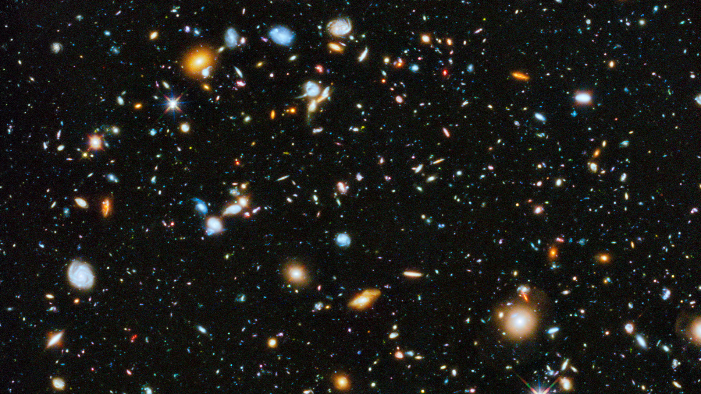
https://hubblesite.org/contents/news-releases/2014/news-2014-27.html
Notes:
https://hubblesite.org/contents/news-releases/2014/news-2014-27.html
Astronomers using the Hubble Space Telescope have assembled a comprehensive picture of the evolving universe – among the most colorful deep space images ever captured by the 24-year-old telescope. This study, which includes ultraviolet light, provides the missing link in star formation.
CREDITS:Image: NASA, ESA, H. Teplitz and M. Rafelski (IPAC/Caltech), A. Koekemoer (STScI), R. Windhorst (Arizona State University), and Z. Levay (STScI); Science: NASA, ESA, H. Teplitz and M. Rafelski (IPAC/Caltech), P. Kurczynski (Rutgers University), N. Bond (Goddard Space Flight Center), E. Soto (Catholic University), N. Grogin and A. Koekemoer (STScI), H. Atek (École Polytechnique Fédérale de Lausanne, Switzerland), T. Brown and D. Coe (STScI), J. Colbert and Y. Dai (IPAC/Caltech), H. Ferguson (STScI), S. Finkelstein (University of Texas, Austin), J. Gardner (Goddard Space Flight Center), E. Gawiser (Rutgers University), M. Giavalisco (University of Massachusetts, Amherst), C. Gronwall (Penn State University), D. Hanish (IPAC/Caltech), K.-S. Lee (Purdue University), Z. Levay (STScI), D. De Mello (Catholic University), S. Ravindranath and R. Ryan (STScI), B. Siana (University of California, Riverside), C. Scarlata (University of Minnesota, Minneapolis), E. Voyer (CNRS, Marseille), and R. Windhorst (Arizona State University)

Slide 2
HUBBLE UNVEILS ITS MOST COLORFUL VIEW OF THE UNIVERSE (ZOOM AND PAN)
Browse the Link below and play!
https://hubblesite.org/contents/media/videos/2014/27/766-Video.html
Notes:
https://hubblesite.org/contents/news-releases/2014/news-2014-27.html
CREDITS:Image: NASA, ESA, H. Teplitz and M. Rafelski (IPAC/Caltech), A. Koekemoer (STScI), R. Windhorst (Arizona State University), and Z. Levay (STScI); Science: NASA, ESA, H. Teplitz and M. Rafelski (IPAC/Caltech), P. Kurczynski (Rutgers University), N. Bond (Goddard Space Flight Center), E. Soto (Catholic University), N. Grogin and A. Koekemoer (STScI), H. Atek (École Polytechnique Fédérale de Lausanne, Switzerland), T. Brown and D. Coe (STScI), J. Colbert and Y. Dai (IPAC/Caltech), H. Ferguson (STScI), S. Finkelstein (University of Texas, Austin), J. Gardner (Goddard Space Flight Center), E. Gawiser (Rutgers University), M. Giavalisco (University of Massachusetts, Amherst), C. Gronwall (Penn State University), D. Hanish (IPAC/Caltech), K.-S. Lee (Purdue University), Z. Levay (STScI), D. De Mello (Catholic University), S. Ravindranath and R. Ryan (STScI), B. Siana (University of California, Riverside), C. Scarlata (University of Minnesota, Minneapolis), E. Voyer (CNRS, Marseille), and R. Windhorst (Arizona State University)

Slide 3
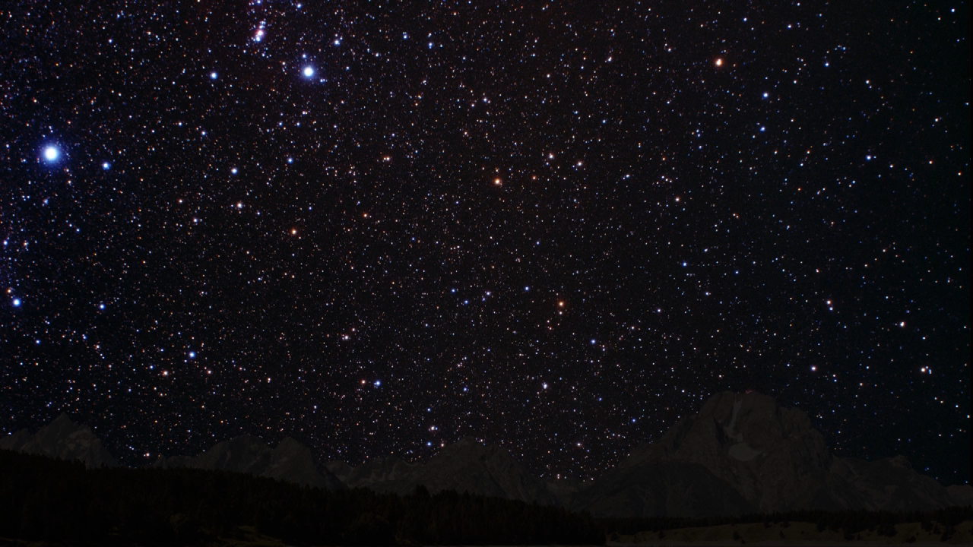
Notes:
About This Video
This video is a zoom into a small patch of sky in the constellation Fornax. This is the target area for the Hubble Ultra Deep Field, which was first observed in 2003. The low density of bright foreground stars in this region of the heavens allows astronomers to clearly view approximately 10,000 dimmer, more distant galaxies. This latest image combines separate observations taken in ultraviolet, visible, and near-infrared light. The composite yields the most colorful view of the far universe to date. It yields new clues to the birth rate of stars over the universe's 13-billion-year history.
CREDITS:NASA, ESA, and G. Bacon (STScI); Acknowledgment: NASA, ESA, H. Teplitz and M. Rafelski (IPAC/Caltech), A. Koekemoer (STScI), R. Windhorst (ASU), and Z. Levay (STScI)

Slide 4
Computer science | & computers (gates)
astronomy | & telescopes (Stars)
“Computer science is no more about computers than astronomy is about telescopes” - Edsger Dijkstra
Notes:
Zoom into universe and stars
Zoom into cpu and gates
Mixing tools w/ Science but knowing the tools helps a lot with science

Slide 5
Problems

Slide 6
Distance
Height
Length
Problems

Slide 7
Computable
Theory of Automata
Theory of Computation
Theory of Computer Science
Problems

Slide 8
Problems
Programs

Slide 9
Problems
Algorithm
Data

Slide 10
Algorithm Design
Algorithm Analysis
Artificial Intelligence (AI)
Machine Learning
Data Mining
Data Structure (Memory)
File Structure (File Systems)
Database Management Sys.
Data Warehouse
Big Data
Cloud
Algo
Data

Slide 11




Slide 12
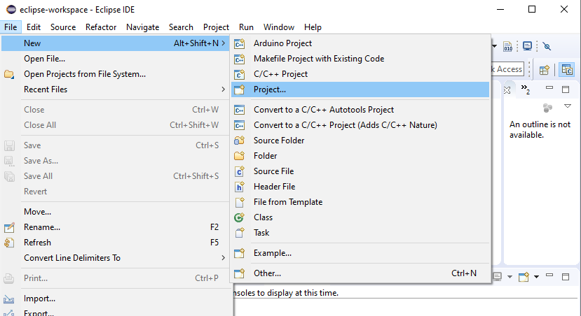
Notes:
https://www.youtube.com/watch?v=4ZQJjXGr1Gw

Slide 13
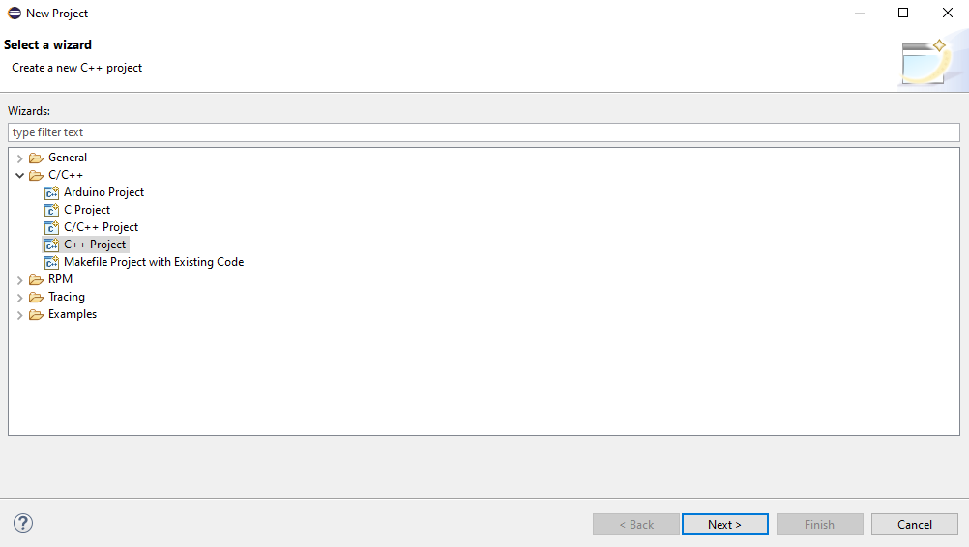

Slide 14
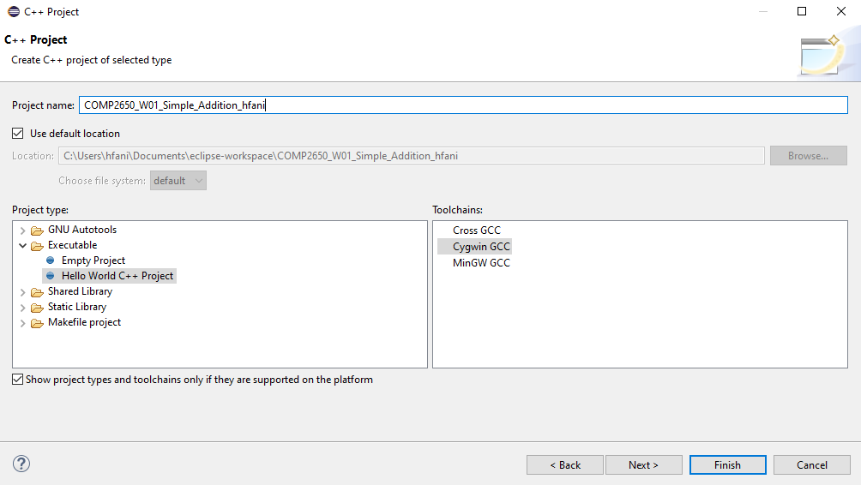

Slide 15
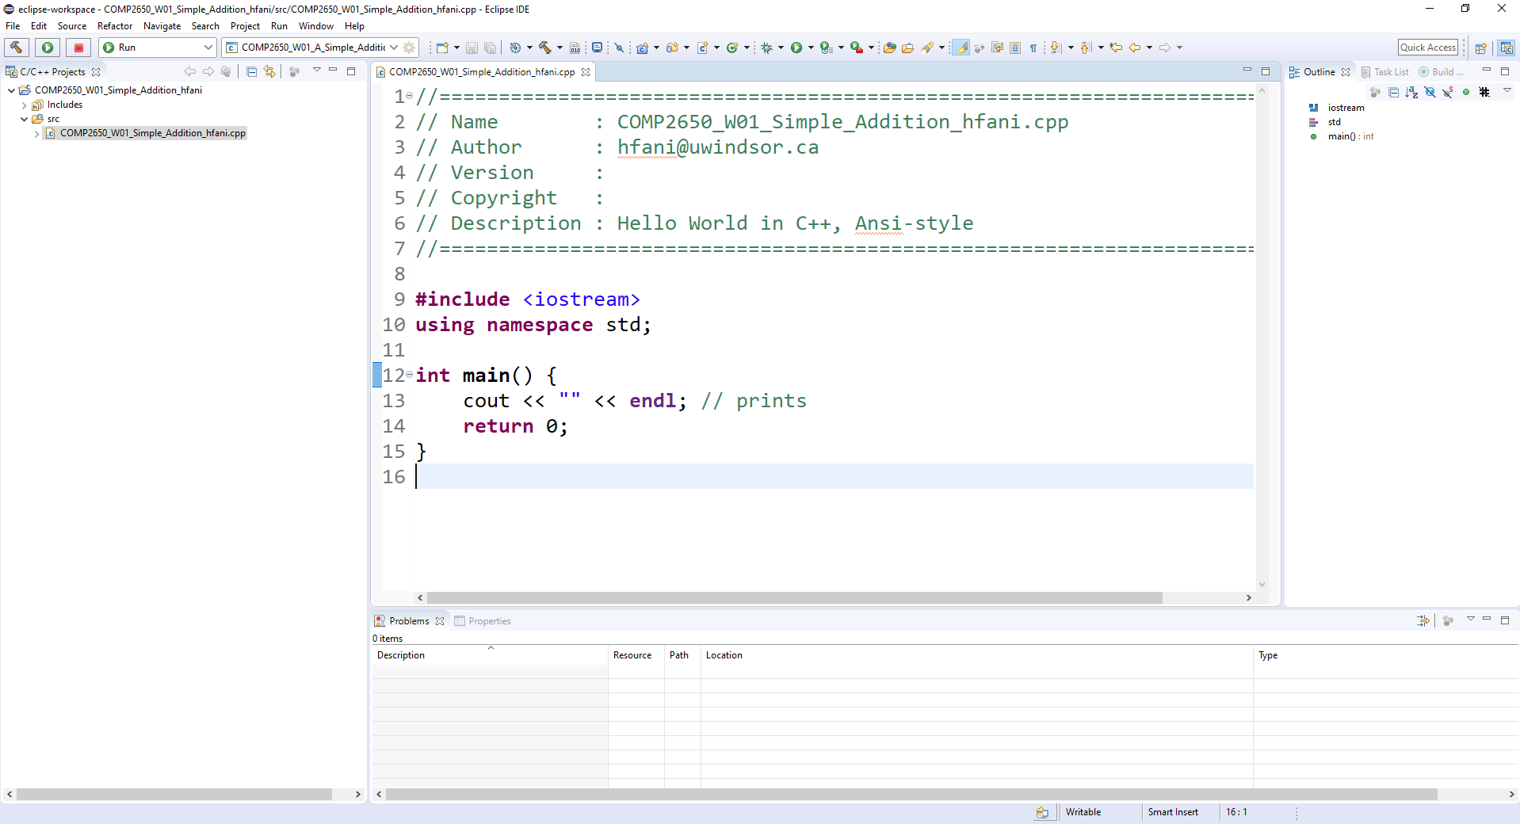

Slide 16
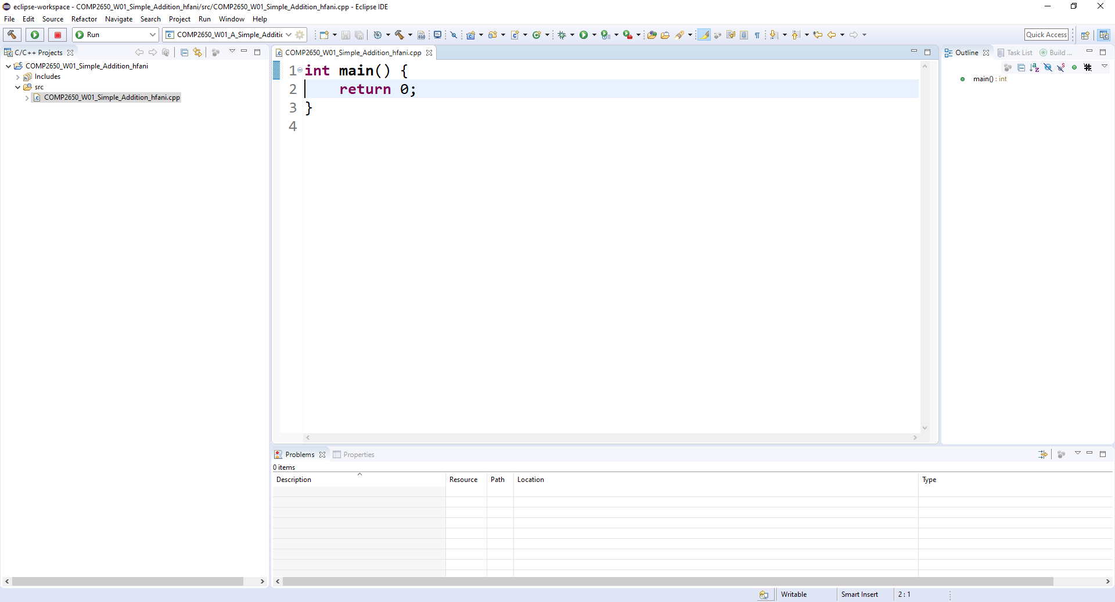

Slide 17
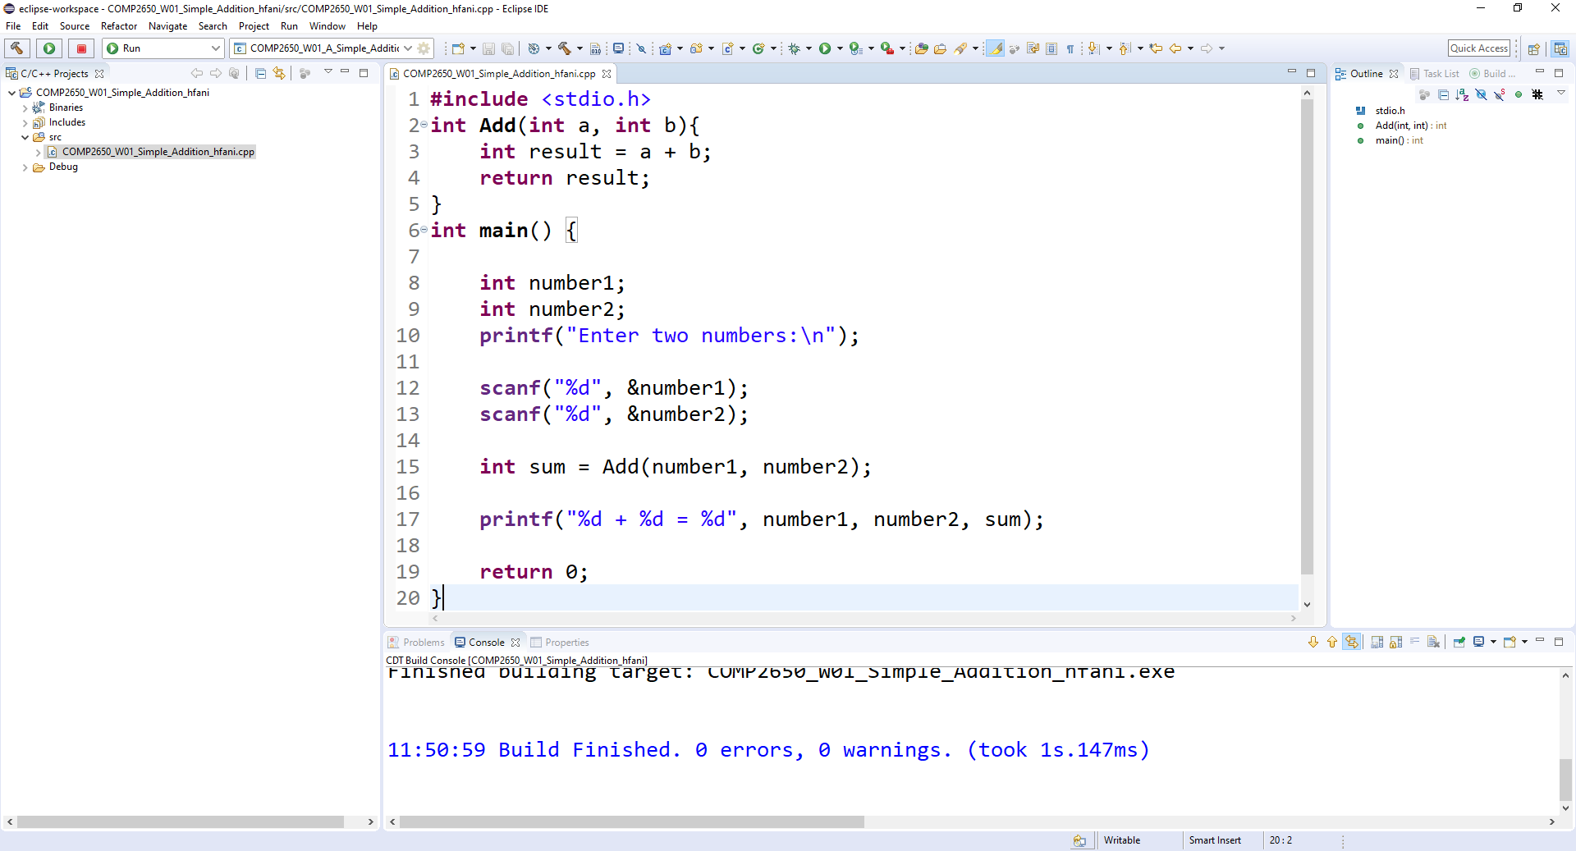

Slide 18
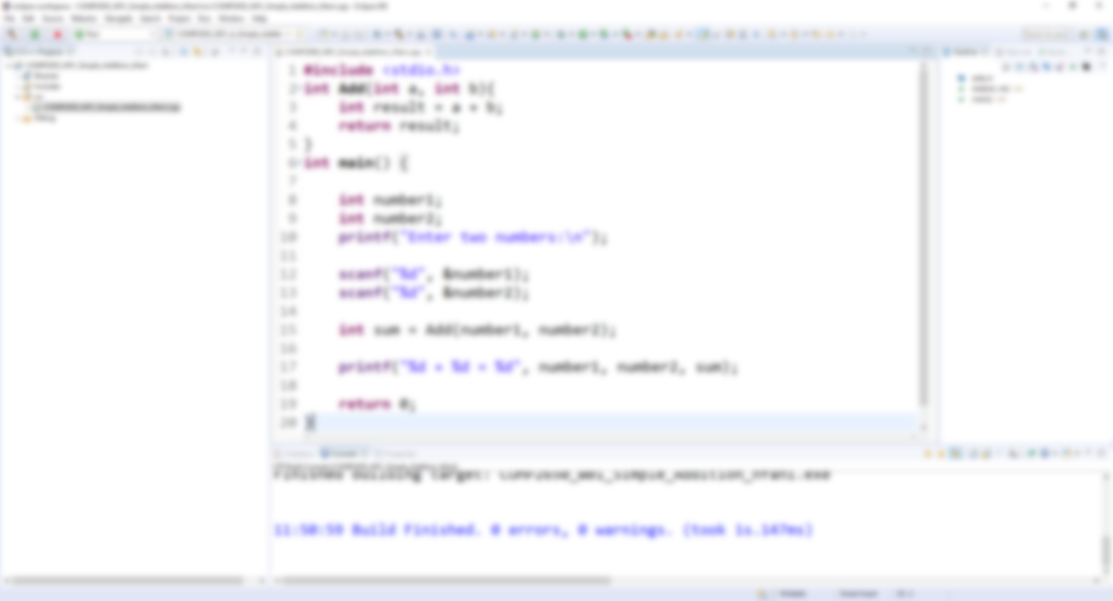

Slide 20


Slide 21
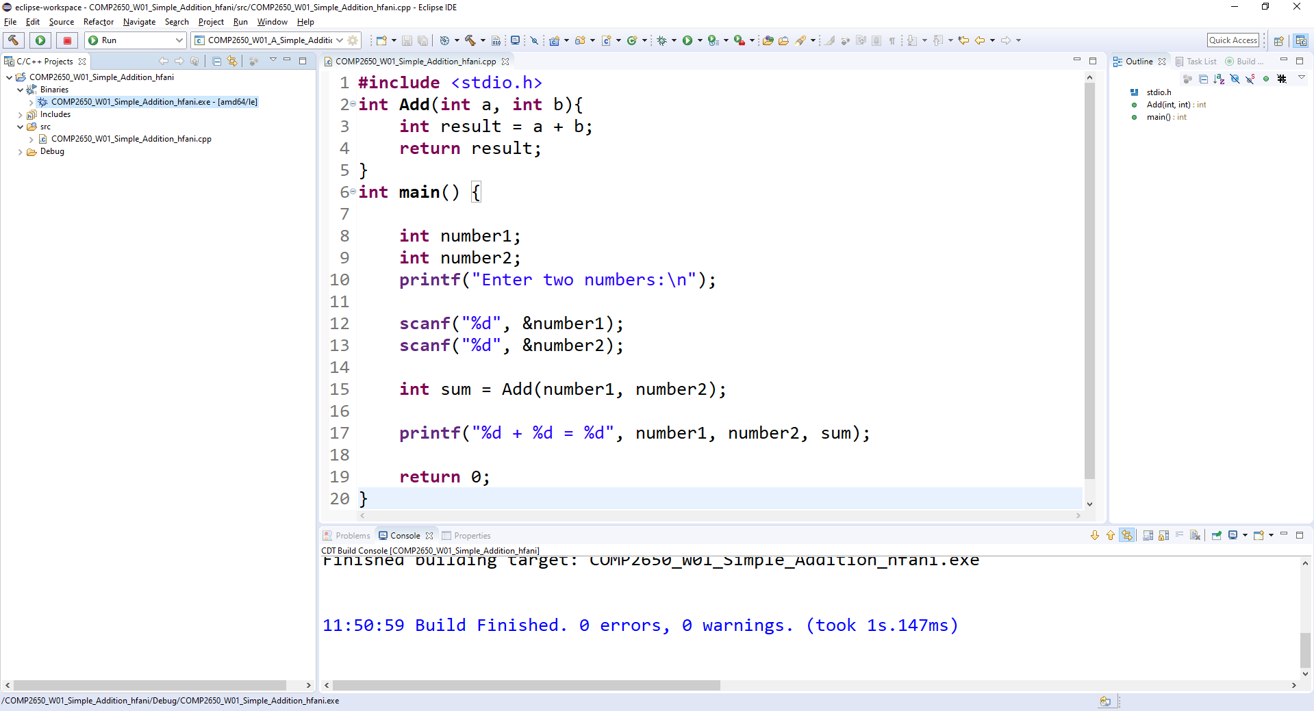

Slide 22
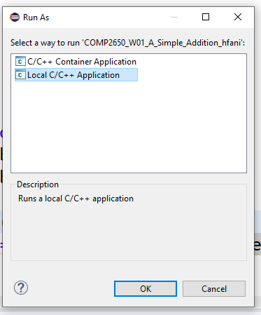

Slide 23
Enter two integers:
12
35
12 + 35 = 47

Slide 24
Enter two integers:
999999
1
999999 + 1 = 1000000

Slide 25
Enter two integers:
999999999999999
1

Slide 26
Enter two integers:
999999999999999
1
-1530494977 + 1 = -1530494976

Slide 27
Enter two integers:
999999999999999
1
-1530494977 + 1 = -1530494976

Slide 28
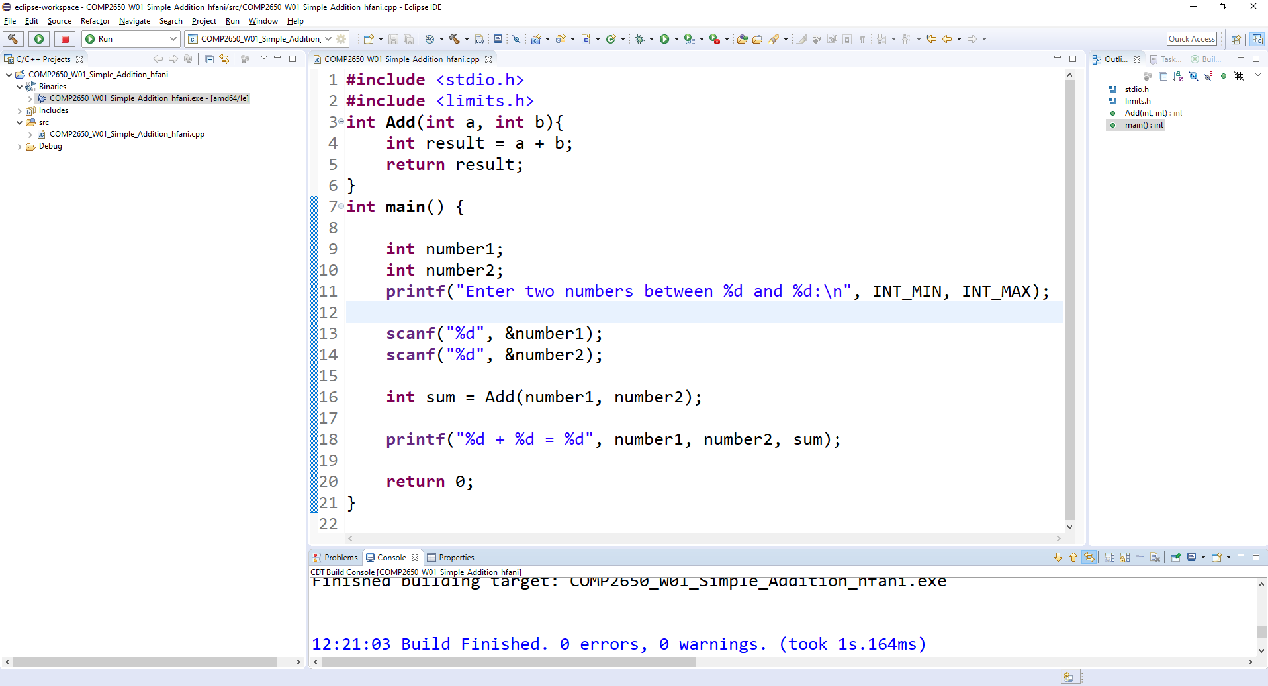

Slide 29
Enter two integers between -2147483648 and 2147483647:
12
15
12 + 15 = 27

Slide 30
Enter two integers between -2147483648 and 2147483647:
2147483647
1

Slide 31
Enter two integers between -2147483648 and 2147483647:
2147483647
1
2147483647 + 1 = -2147483648

Slide 32
Enter two integers between -2147483648 and 2147483647:
2147483647
2
2147483647 + 2 = -2147483647

Slide 33
Enter two integers:
2147483647
1
2147483647 + 1 = 2147483648

Slide 34
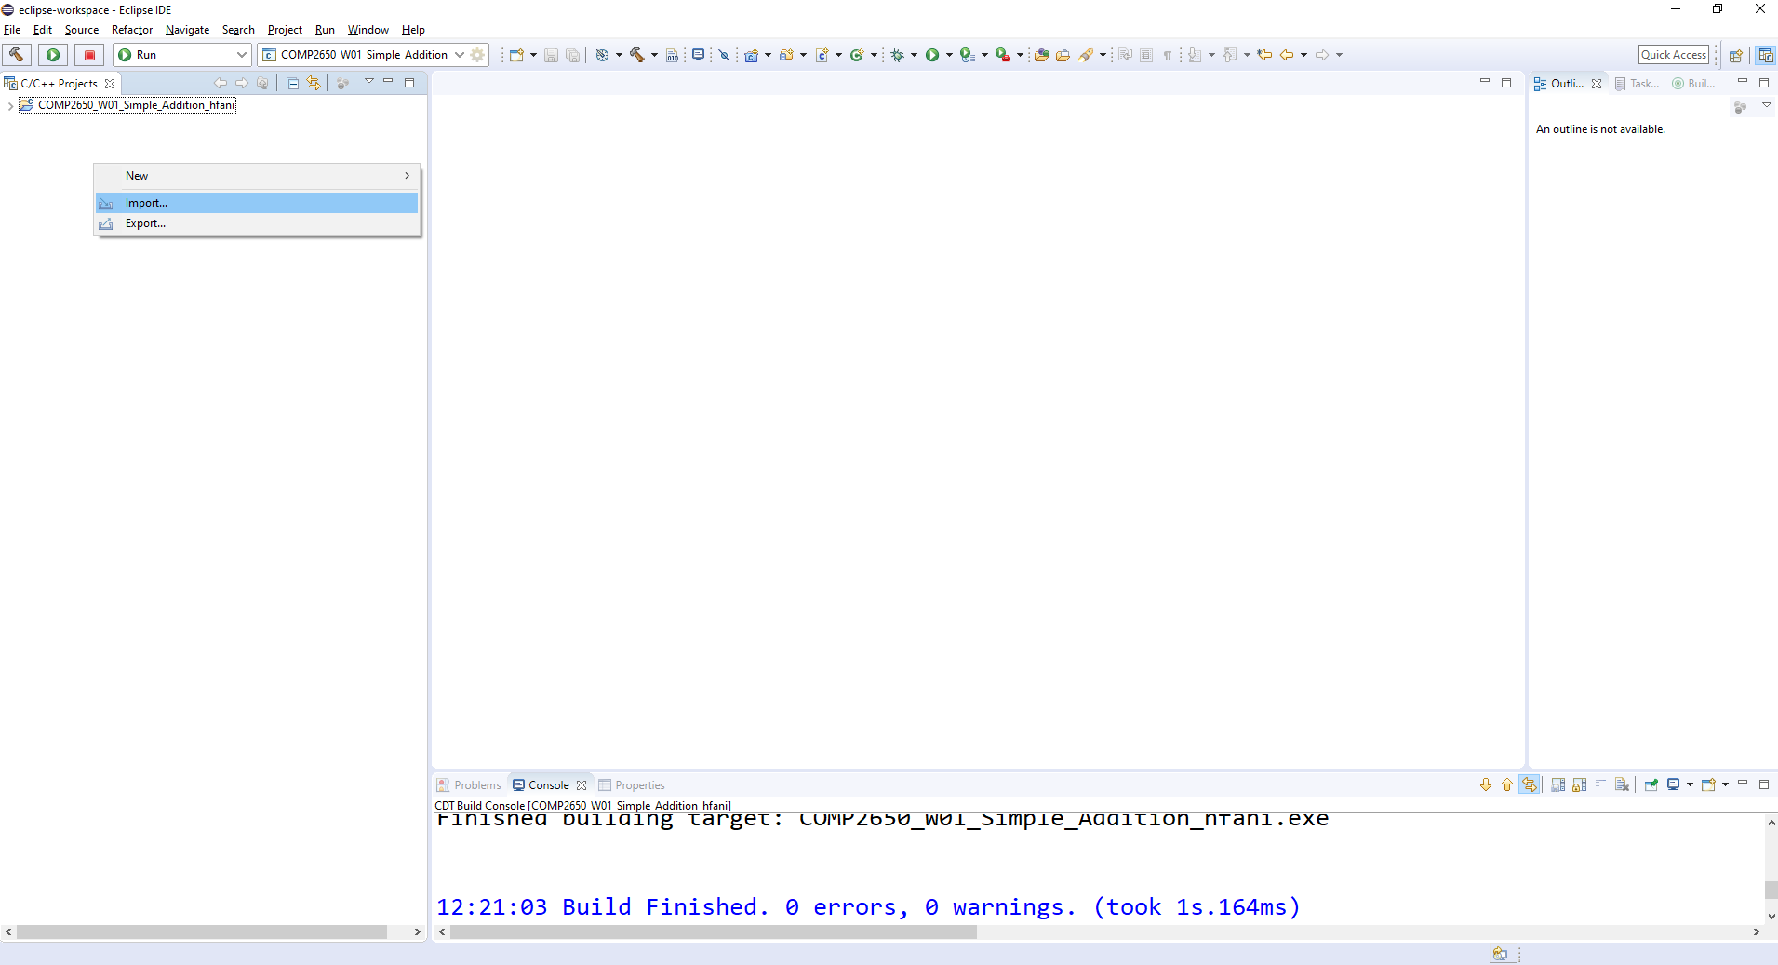

Slide 35
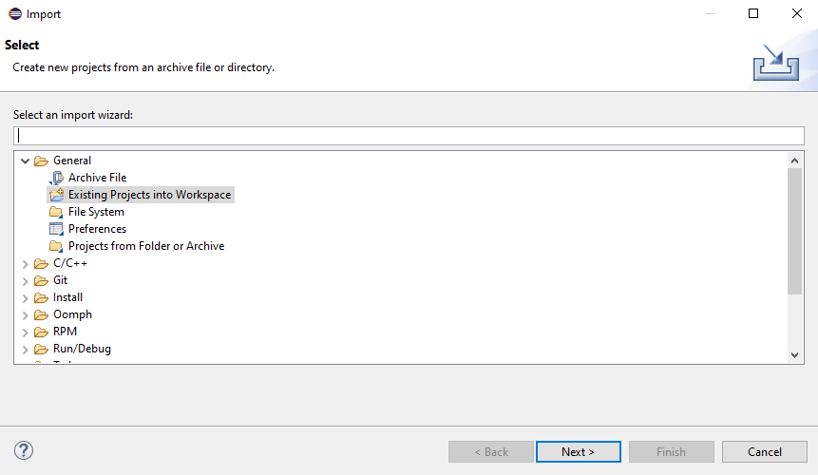

Slide 36
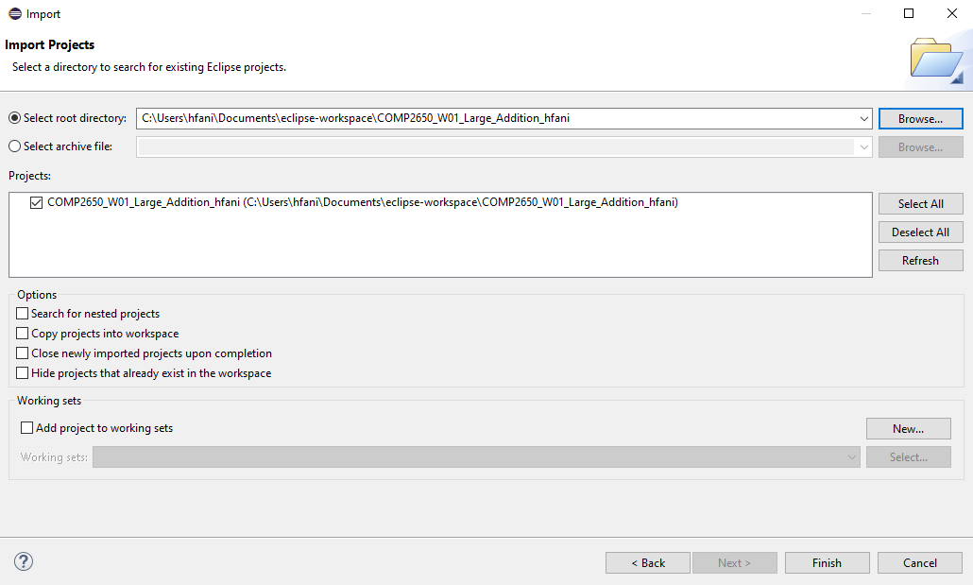

Slide 37
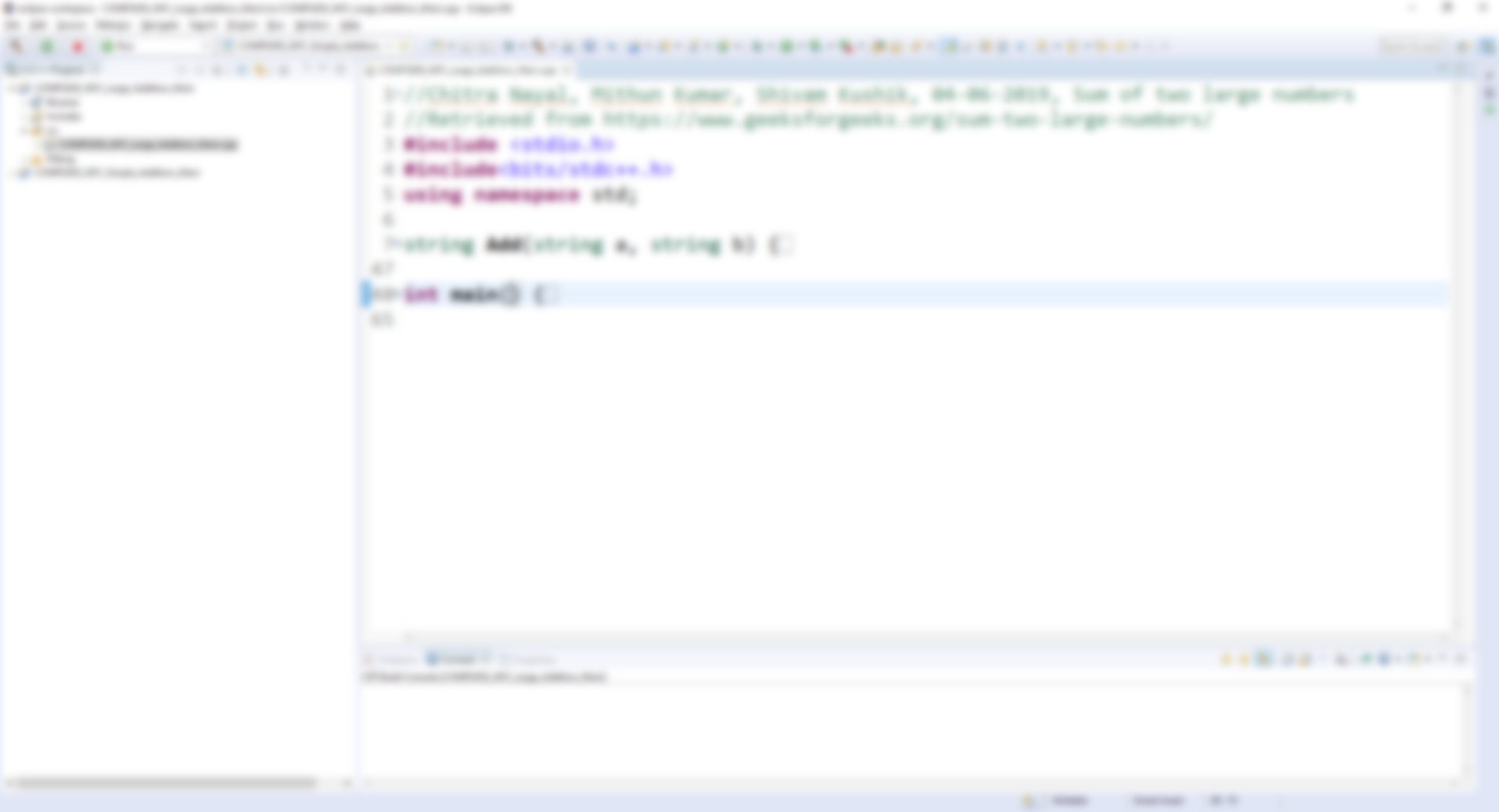
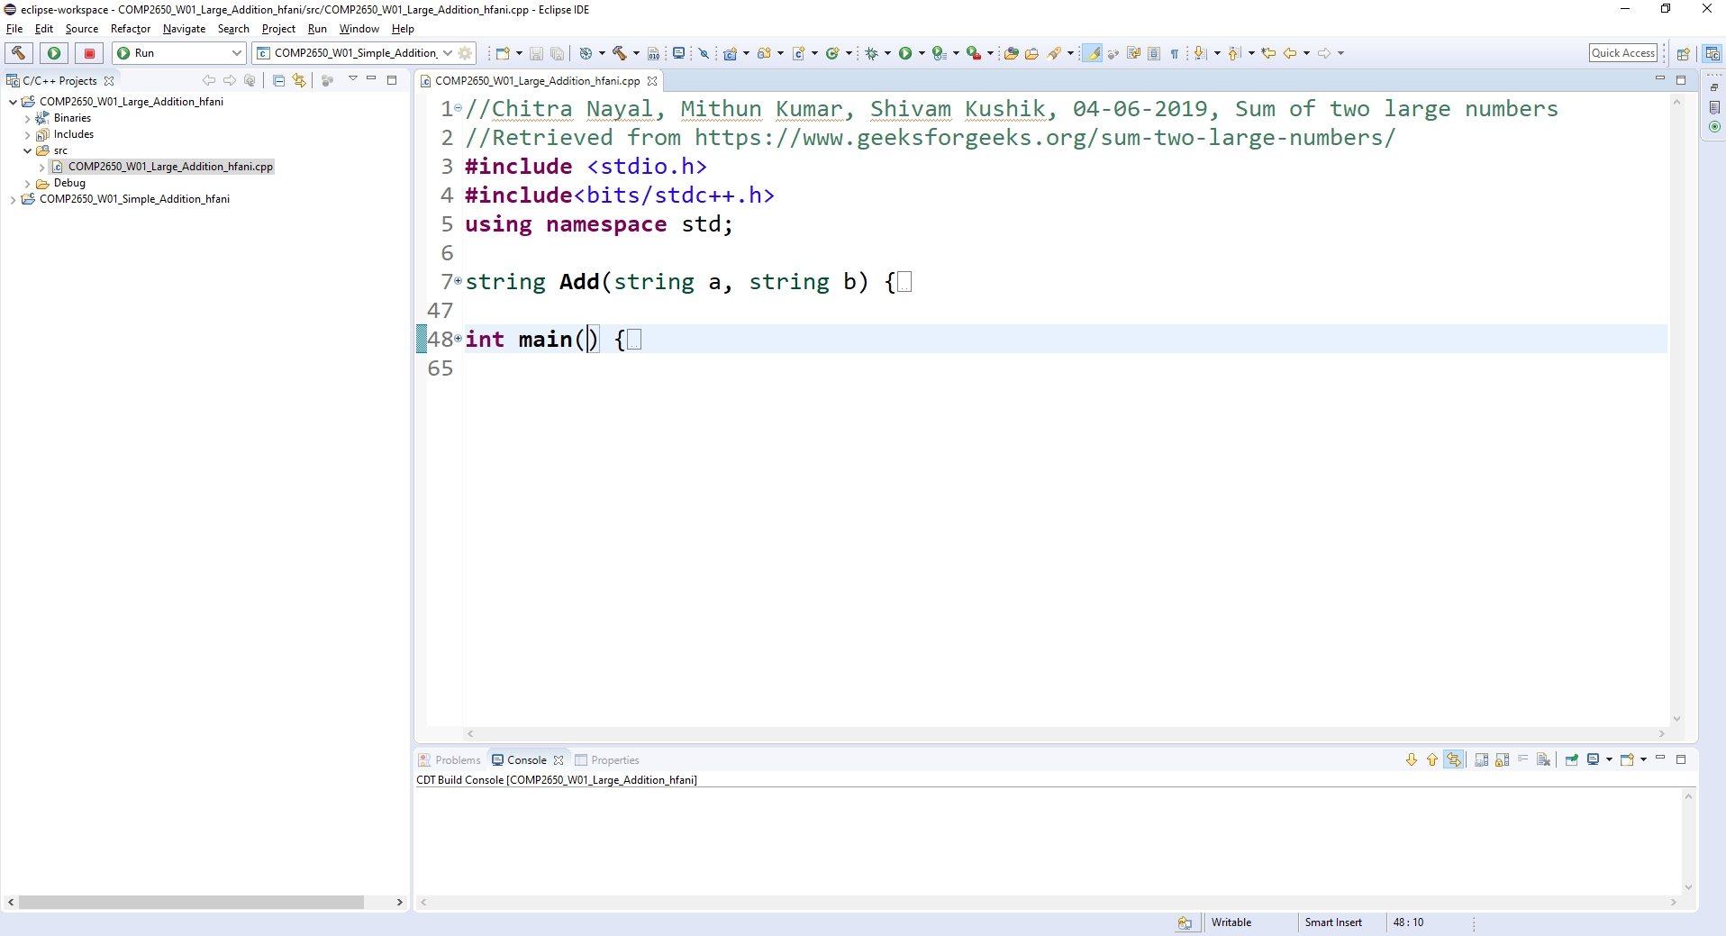

Slide 38
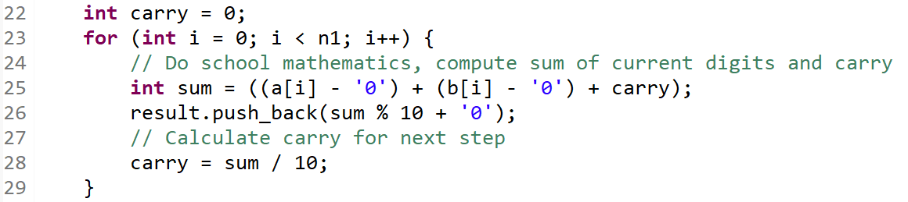

Slide 39
Enter two integers:
2147483647
1
2147483647 + 1 = 2147483648

Slide 40
Enter two integers:
999999999999999999999999999999999999999999999
1
999999999999999999999999999999999999999999999 + 1 = 1000000000000000000000000000000000000000000000

Slide 41
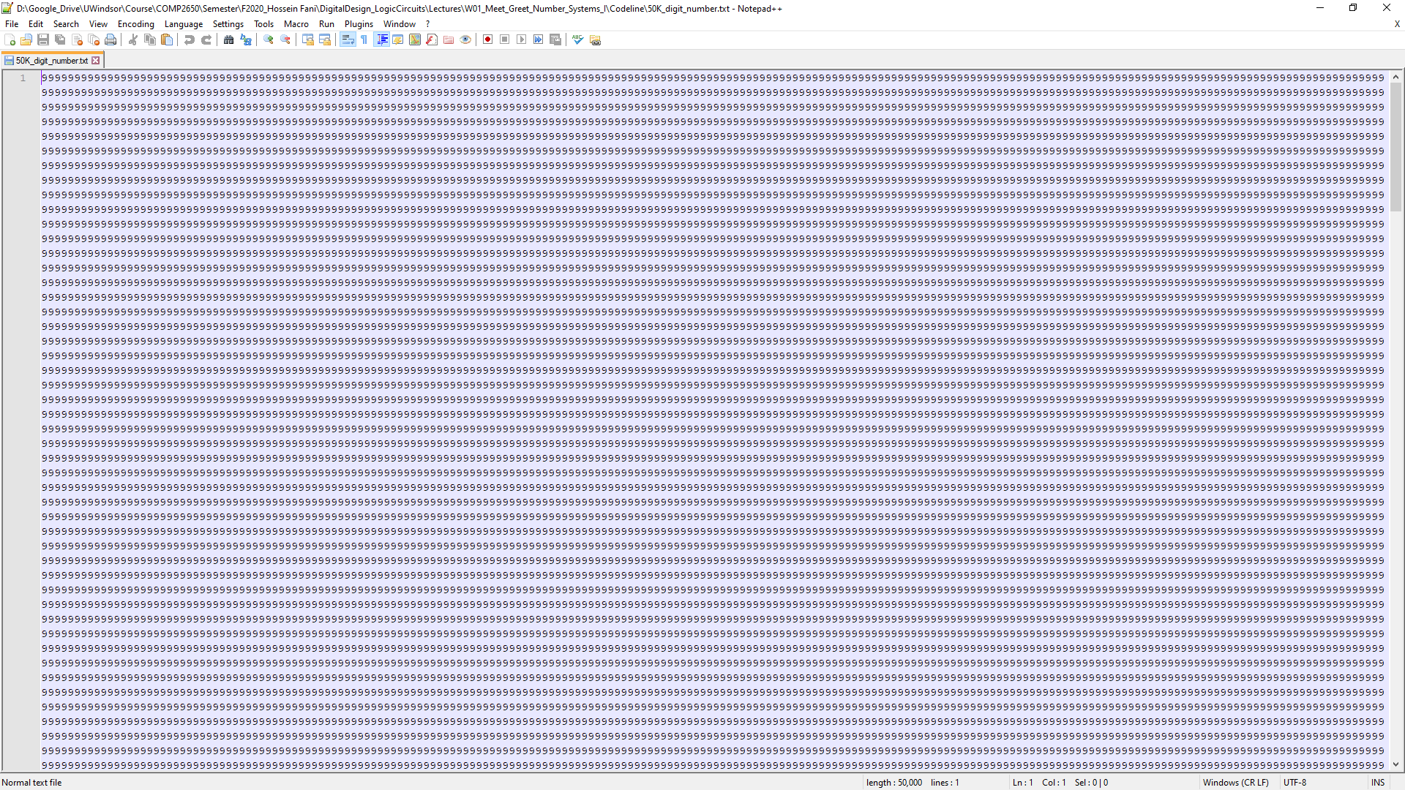

Slide 42
BUILD SUCCESSFUL (total time: 715ms)
Enter two integers:
999...99999 => 50,000 digits
999...99999 => 50,000 digits
999...99999 + 999...99999 = ?

Slide 43
BUILD SUCCESSFUL (total time: 715ms)
Enter two integers:
999...99999 => 50,000 digits
999...99999 => 50,000 digits
999...99999 + 999...99999 = 1999 ... 9998 => 50,001 digits

Slide 44
BUILD SUCCESSFUL (total time: 715ms)
Enter two integers:
999...99999 => 50,000 digits
999...99999 => 50,000 digits
999...99999 + 999...99999 = 1999 ... 9998 => 50,001 digits
Total time = ?

Slide 45
BUILD SUCCESSFUL (total time: 715ms)
Enter two integers:
999...99999 => 50,000 digits
999...99999 => 50,000 digits
999...99999 + 999...99999 = 1999 ... 9998 => 50,001 digits
Total time = 0.000000

Slide 46
BUILD SUCCESSFUL (total time: 715ms)
Enter two integers:
999...99999 => 50,000 digits
999...99999 => 50,000 digits
How many iterations:
?
Total time = ?

Slide 47
Matrix

Slide 48
BUILD SUCCESSFUL (total time: 715ms)
Enter two integers:
999...99999 => 50,000 digits
999...99999 => 50,000 digits
How many iterations:
1
Total time = 0.000000

Slide 49
BUILD SUCCESSFUL (total time: 715ms)
Enter two integers:
999...99999 => 50,000 digits
999...99999 => 50,000 digits
How many iterations:
100
Total time = ?

Slide 50
BUILD SUCCESSFUL (total time: 715ms)
Enter two integers:
999...99999 => 50,000 digits
999...99999 => 50,000 digits
How many iterations:
1,2,3,…,900,…, 1000
Total time =

Slide 51
Problems
Algorithm
Data
Machine

Slide 52
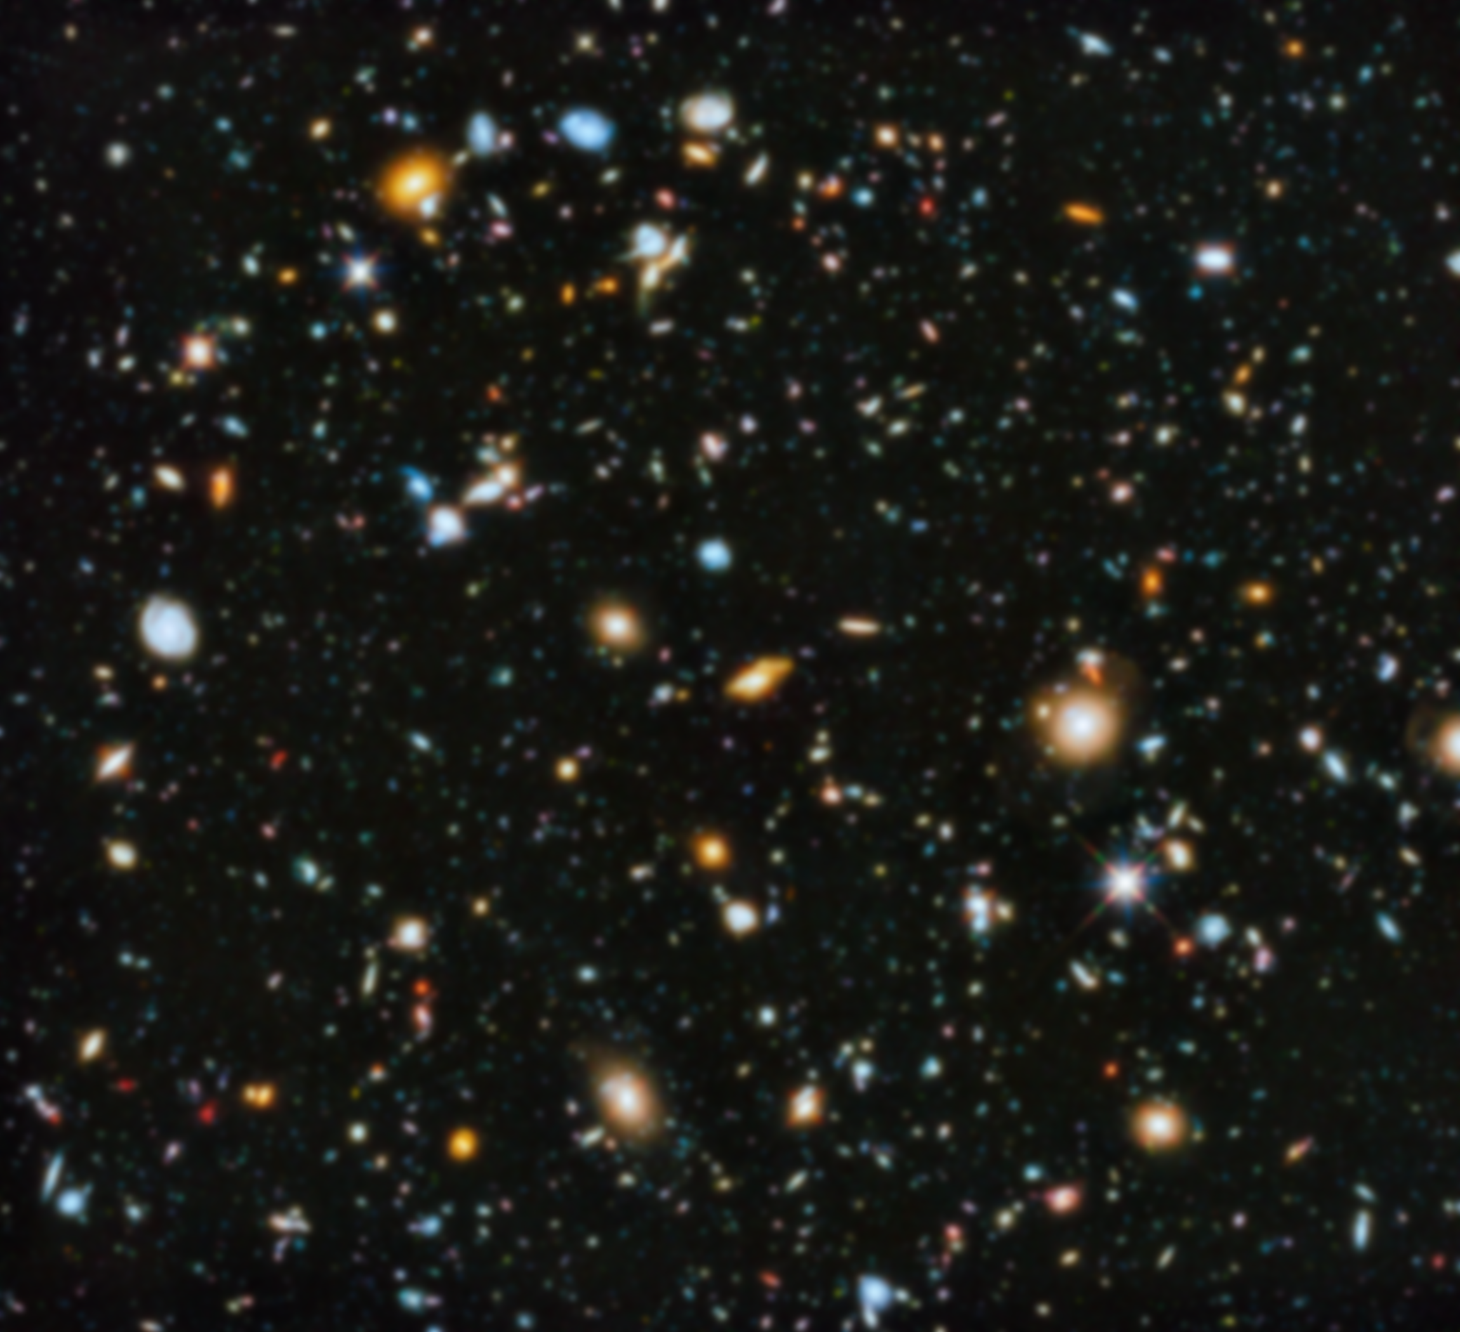
Algorithm Design
Algorithm Analysis
Artificial Intelligence (AI)
Machine Learning
Data Mining
Data Structure
File Structure
Database Management Sys.
Data Warehouse
Big Data
Cloud
Algo
Data
Machine
Digital Design (Logic Circuits)
Computer Architecture
Microprocessor Programming

Slide 53
Algorithm Design
Algorithm Analysis
Artificial Intelligence (AI)
Machine Learning
Data Mining
Data Structure
File Structure
Database Management Sys.
Data Warehouse
Big Data
Cloud
Algo
Data
Machine
Digital Design (Logic Circuits)
Computer Architecture
Microprocessor Programming

Slide 54
Digital design
aka. Logic Circuits
Fall 2020

Slide 55
Digital design
aka. Logic Circuits
blackboard.uwindsor.ca → COMP2650-1-R-2020F-a Computer Architecture I:Digital Design

Slide 56
BLACKBOARD TOUR
Lectures → How To Find → COMP2650-1-R-2020F-a Blackboard Tutorial Video 1: Course Homepage Tour

Slide 57
Learning outcome
aka. Learning Objectives
Learning Outcome → COMP2650_Computer_Architecture_I_Digital_Design_Learning_Outcome.pdf

Slide 58
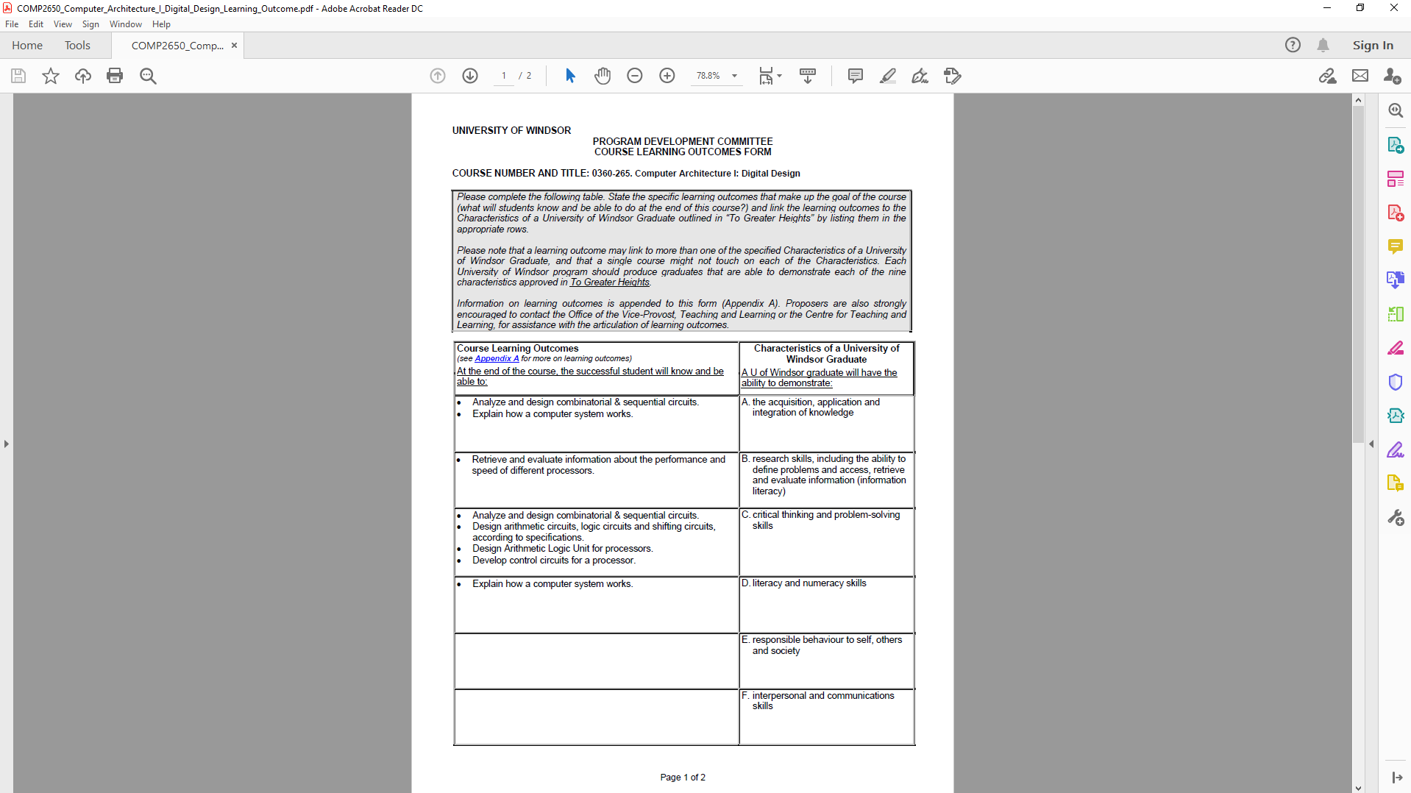
Blackboard Tour | Learning Outcome | Outline (Syllabus) | Laboratory | Discussion Board | Me | Weekly Schedule

Slide 59
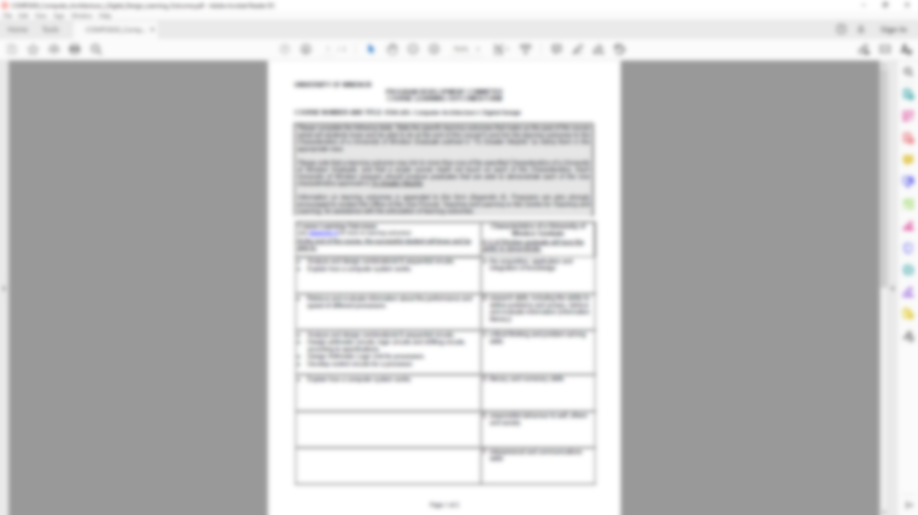
Blackboard Tour | Learning Outcome | Outline (Syllabus) | Laboratory | Discussion Board | Me | Weekly Schedule

Slide 60
Blackboard Tour | Learning Outcome | Outline (Syllabus) | Laboratory | Discussion Board | Me | Weekly Schedule

Slide 61
Blackboard Tour | Learning Outcome | Outline (Syllabus) | Laboratory | Discussion Board | Me | Weekly Schedule

Slide 62
Blackboard Tour | Learning Outcome | Outline (Syllabus) | Laboratory | Discussion Board | Me | Weekly Schedule

Slide 63
Blackboard Tour | Learning Outcome | Outline (Syllabus) | Laboratory | Discussion Board | Me | Weekly Schedule

Slide 64
Blackboard Tour | Learning Outcome | Outline (Syllabus) | Laboratory | Discussion Board | Me | Weekly Schedule

Slide 65
Blackboard Tour | Learning Outcome | Outline (Syllabus) | Laboratory | Discussion Board | Me | Weekly Schedule

Slide 66
Course outline
aka. Course Syllabus
Outline (Syllabus) → COMP2650_Computer_Architecture_I_Digital_Design_Course_Outline.pdf

Slide 67
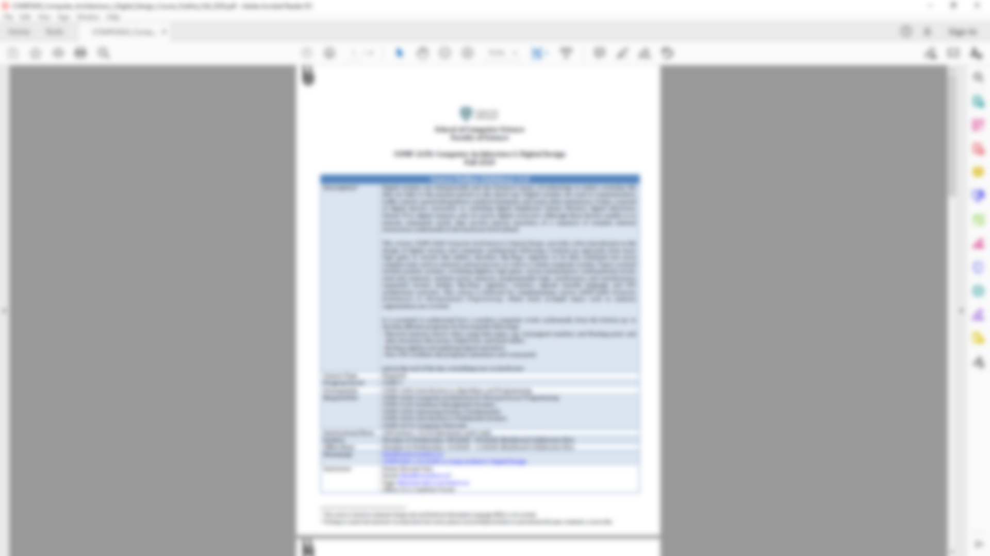
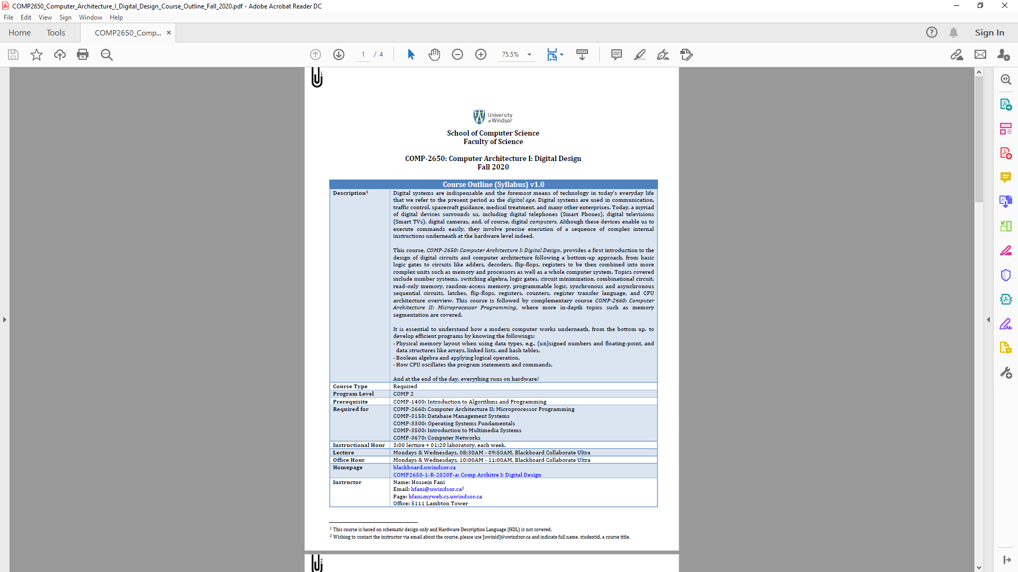
Blackboard Tour | Learning Outcome | Outline (Syllabus) | Laboratory | Discussion Board | Me | Weekly Schedule

Slide 68
Blackboard Tour | Learning Outcome | Outline (Syllabus) | Laboratory | Discussion Board | Me | Weekly Schedule

Slide 69
Blackboard Tour | Learning Outcome | Outline (Syllabus) | Laboratory | Discussion Board | Me | Weekly Schedule

Slide 70
Blackboard Tour | Learning Outcome | Outline (Syllabus) | Laboratory | Discussion Board | Me | Weekly Schedule

Slide 71
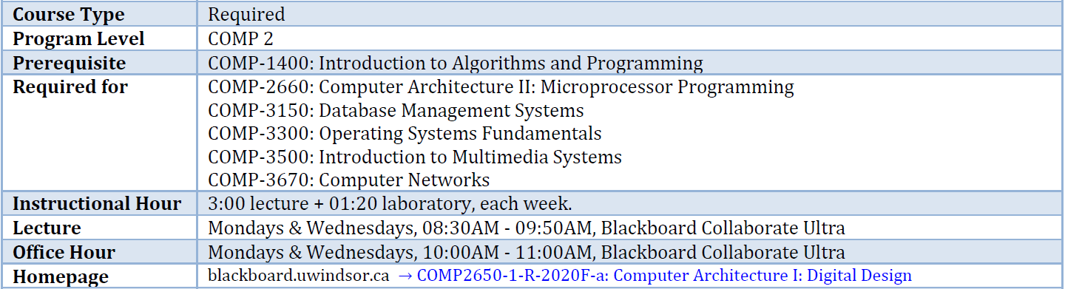
Blackboard Tour | Learning Outcome | Outline (Syllabus) | Laboratory | Discussion Board | Me | Weekly Schedule

Slide 72
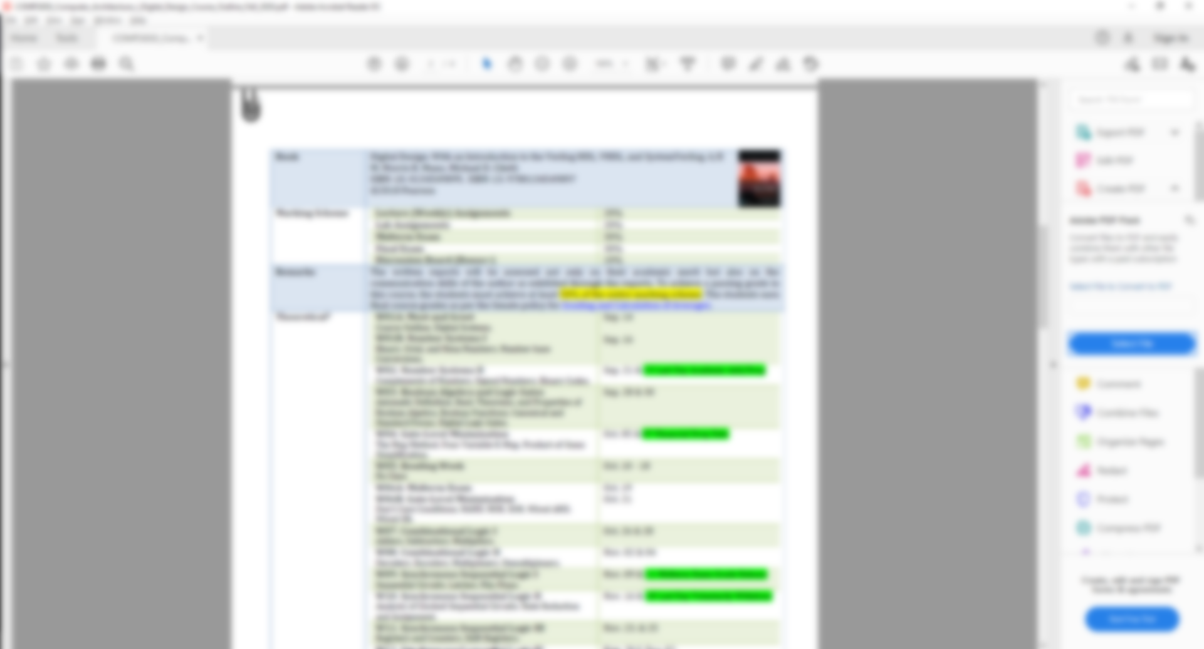
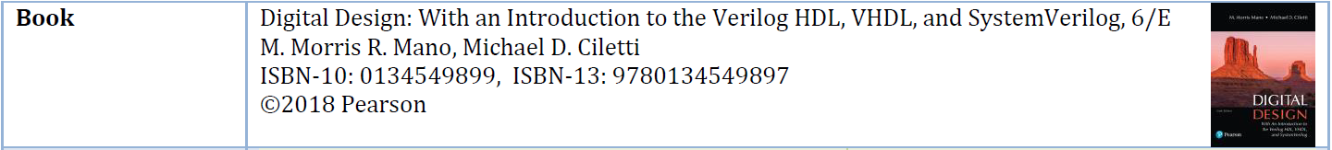
Blackboard Tour | Learning Outcome | Outline (Syllabus) | Laboratory | Discussion Board | Me | Weekly Schedule

Slide 73
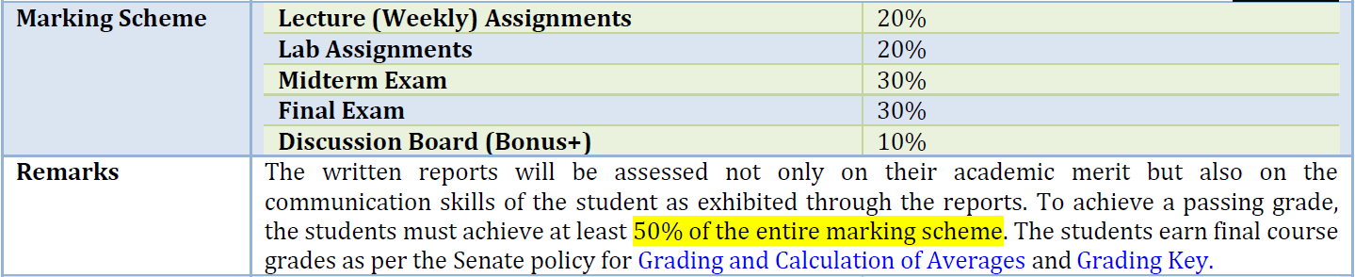
Blackboard Tour | Learning Outcome | Outline (Syllabus) | Laboratory | Discussion Board | Me | Weekly Schedule

Slide 74
Lecture
Assignments
20%
Lab Assignments
20%
Midterm Exam
30%
Final Exam
30%
Discussion Board
+10%
Blackboard Tour | Learning Outcome | Outline (Syllabus) | Laboratory | Discussion Board | Me | Weekly Schedule

Slide 75
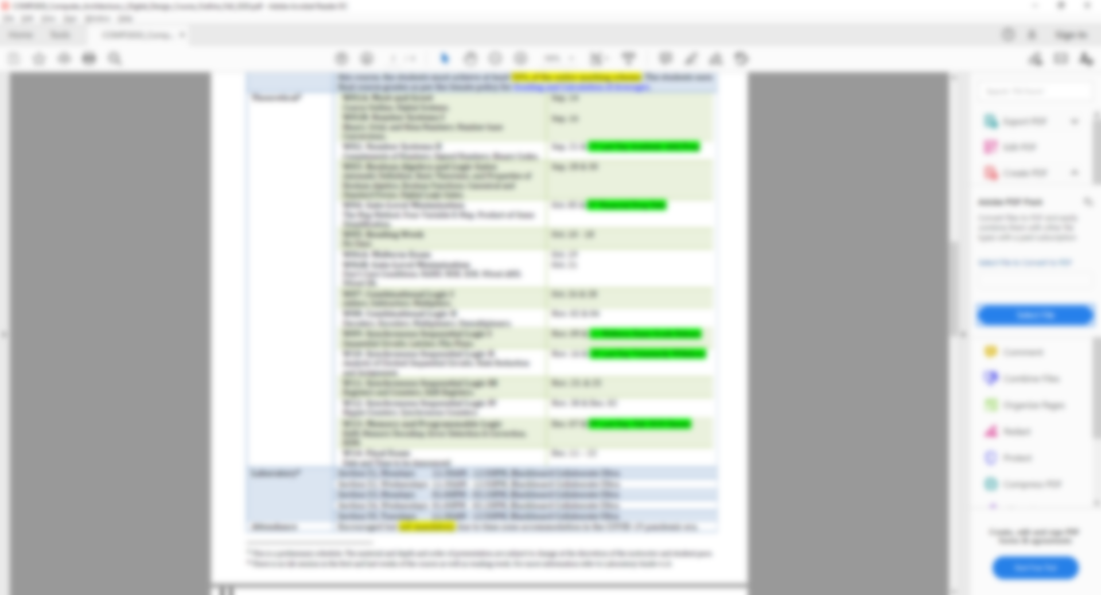
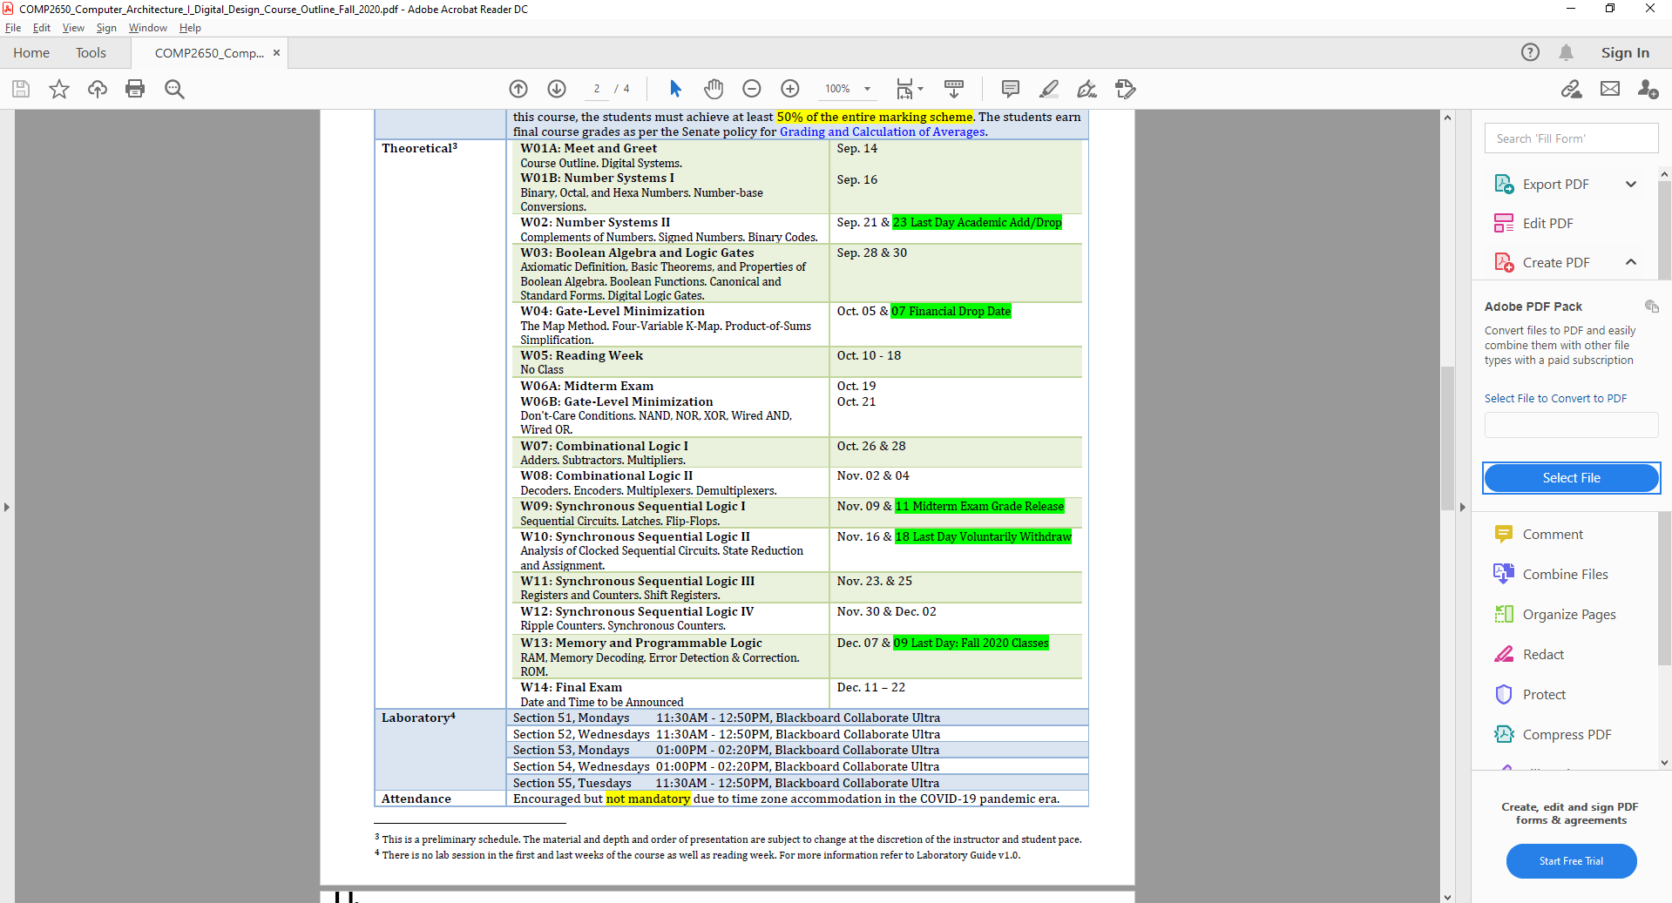
Blackboard Tour | Learning Outcome | Outline (Syllabus) | Laboratory | Discussion Board | Me | Weekly Schedule

Slide 76
Blackboard Tour | Learning Outcome | Outline (Syllabus) | Laboratory | Discussion Board | Me | Weekly Schedule

Slide 77
Blackboard Tour | Learning Outcome | Outline (Syllabus) | Laboratory | Discussion Board | Me | Weekly Schedule

Slide 78
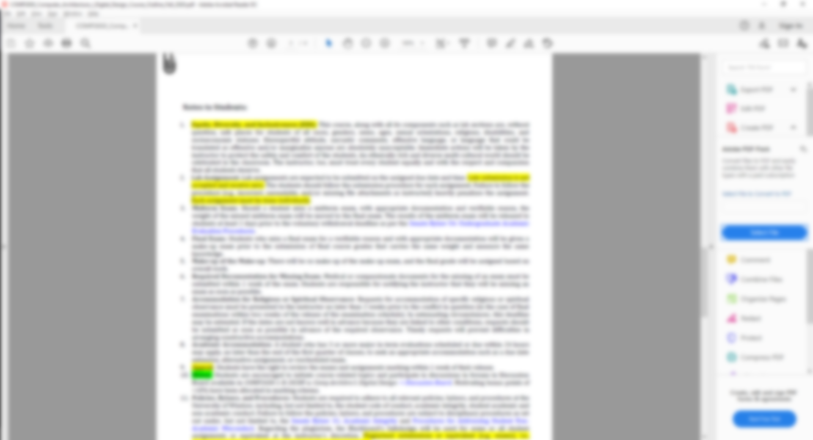
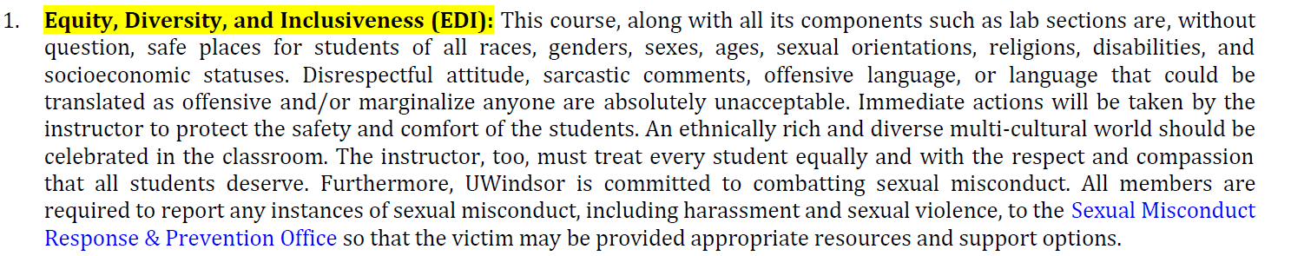
Blackboard Tour | Learning Outcome | Outline (Syllabus) | Laboratory | Discussion Board | Me | Weekly Schedule
Notes:
Needs to be updated

Slide 79
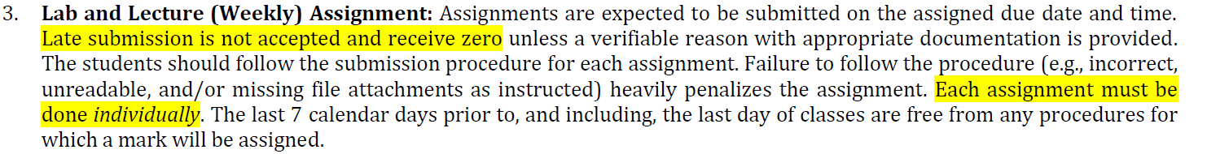
Blackboard Tour | Learning Outcome | Outline (Syllabus) | Laboratory | Discussion Board | Me | Weekly Schedule
Notes:
Needs to be updated

Slide 80
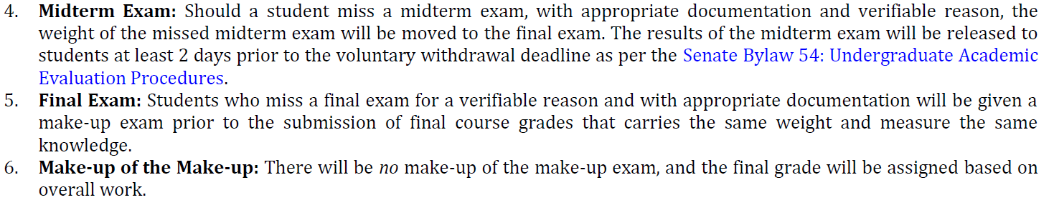
Blackboard Tour | Learning Outcome | Outline (Syllabus) | Laboratory | Discussion Board | Me | Weekly Schedule

Slide 81
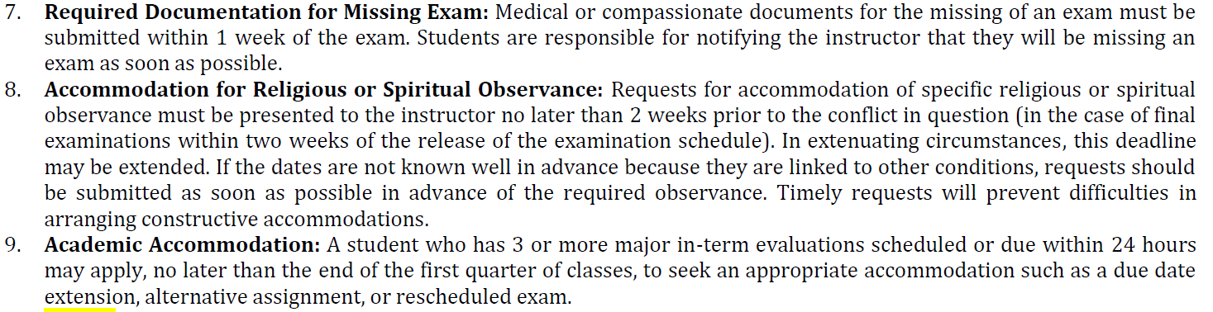
Blackboard Tour | Learning Outcome | Outline (Syllabus) | Laboratory | Discussion Board | Me | Weekly Schedule

Slide 82
Blackboard Tour | Learning Outcome | Outline (Syllabus) | Laboratory | Discussion Board | Me | Weekly Schedule

Slide 83
Blackboard Tour | Learning Outcome | Outline (Syllabus) | Laboratory | Discussion Board | Me | Weekly Schedule

Slide 84
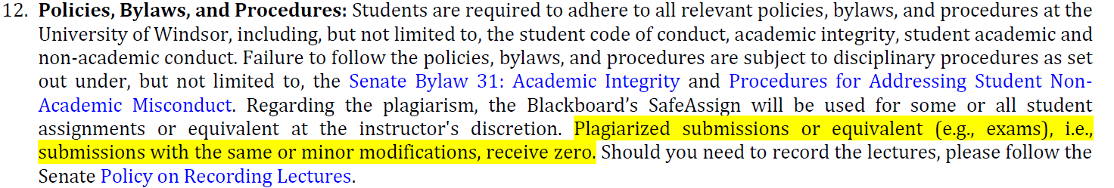
Blackboard Tour | Learning Outcome | Outline (Syllabus) | Laboratory | Discussion Board | Me | Weekly Schedule

Slide 85
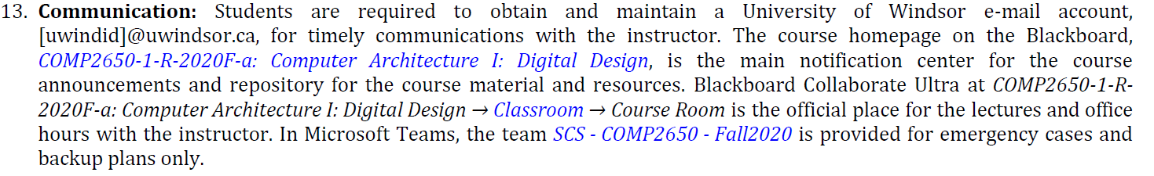
Blackboard Tour | Learning Outcome | Outline (Syllabus) | Laboratory | Discussion Board | Me | Weekly Schedule
Notes:
Needs to be updated

Slide 86
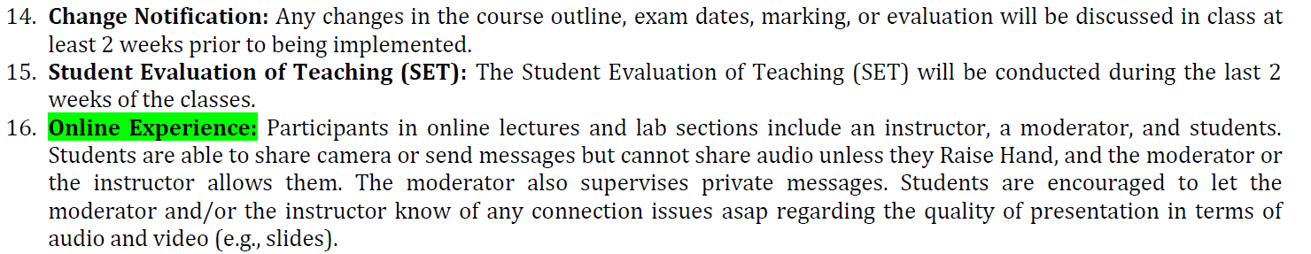
Blackboard Tour | Learning Outcome | Outline (Syllabus) | Laboratory | Discussion Board | Me | Weekly Schedule

Slide 87
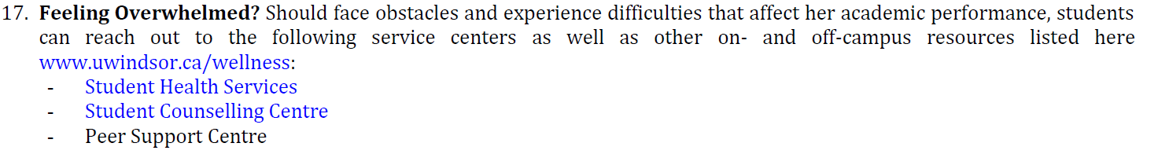
Blackboard Tour | Learning Outcome | Outline (Syllabus) | Laboratory | Discussion Board | Me | Weekly Schedule
Notes:
Needs to be updated

Slide 88
Laboratory guide
aka. Lab Manual
Labs → COMP2650_Computer_Architecture_I_Digital_Design_Lab_Guide.pdf

Slide 89
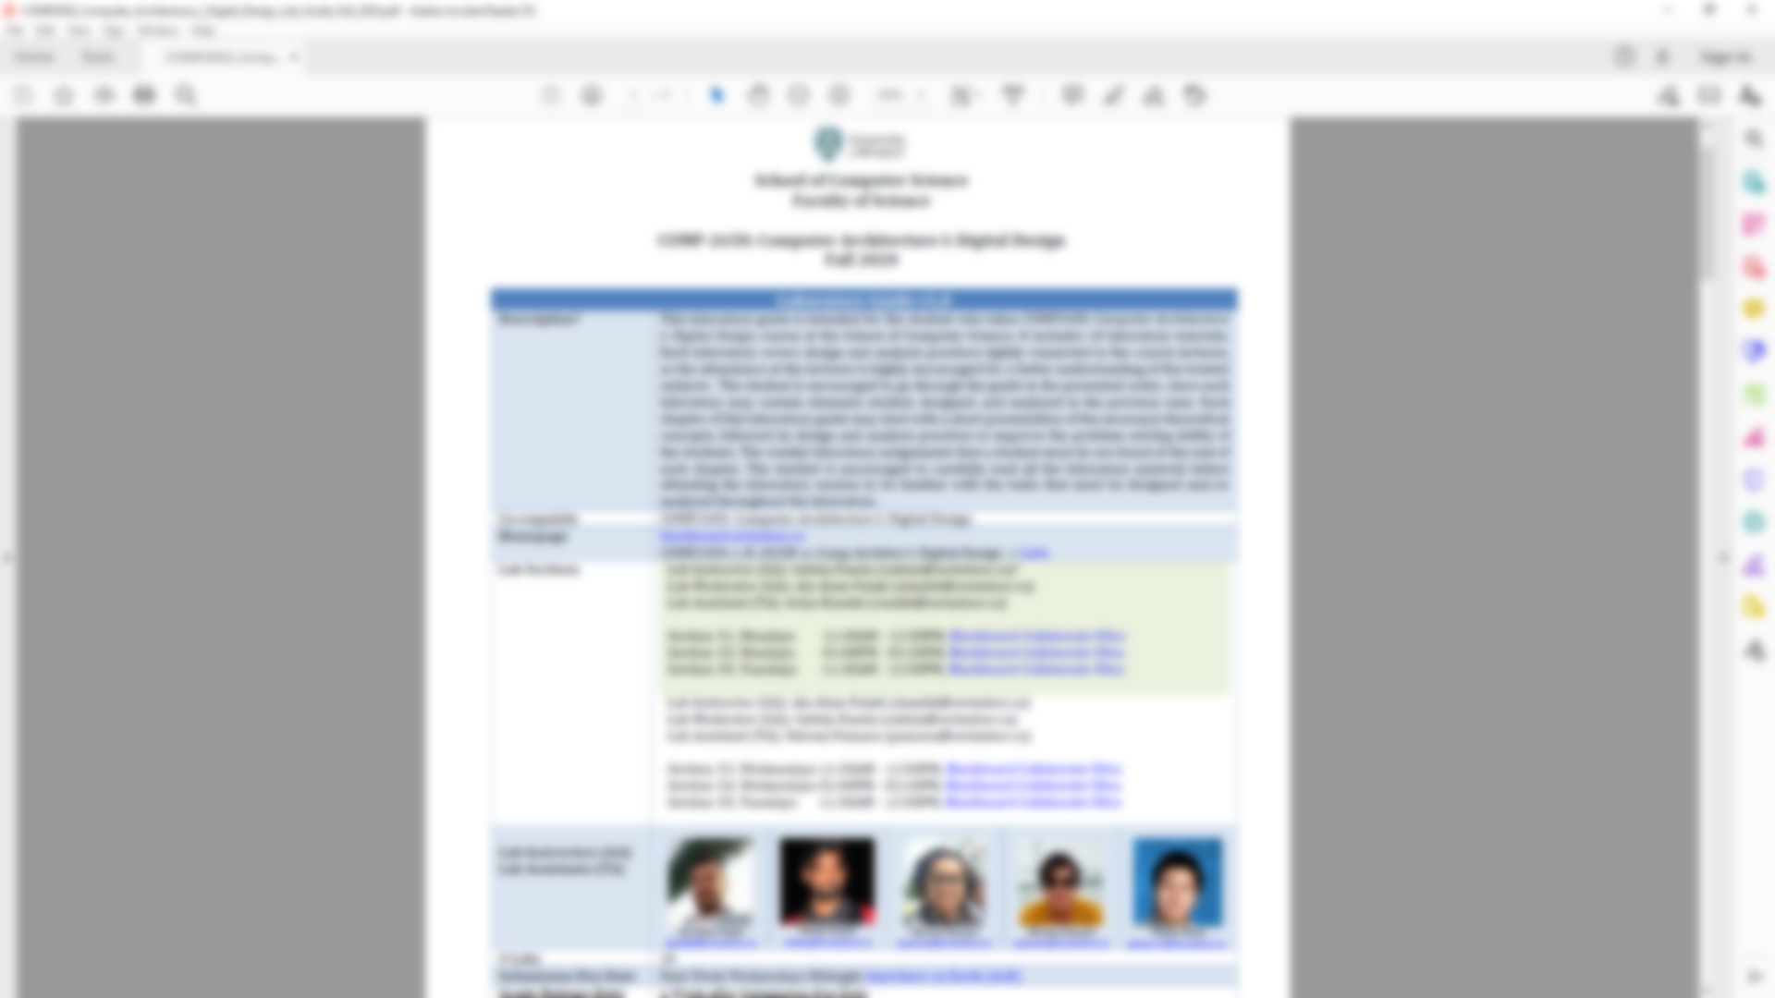
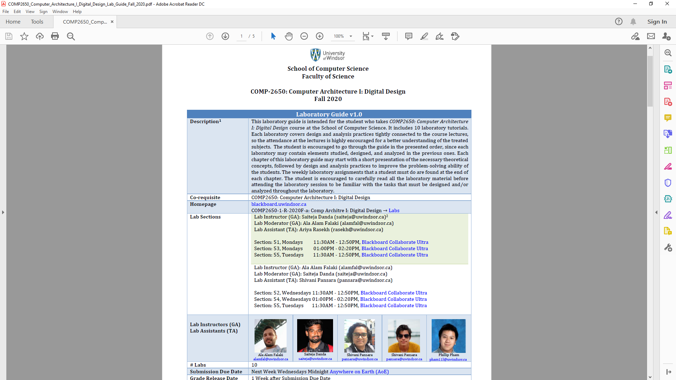
Blackboard Tour | Learning Outcome | Outline (Syllabus) | Laboratory | Discussion Board | Me | Weekly Schedule

Slide 90
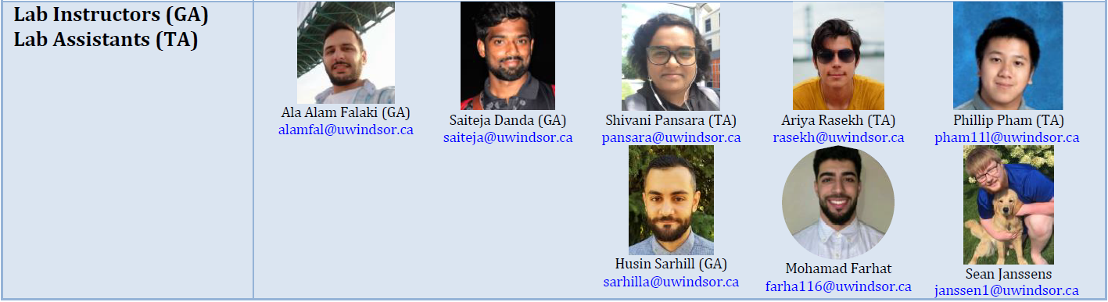
Blackboard Tour | Learning Outcome | Outline (Syllabus) | Laboratory | Discussion Board | Me | Weekly Schedule
Notes:
Needs to be updated

Slide 91
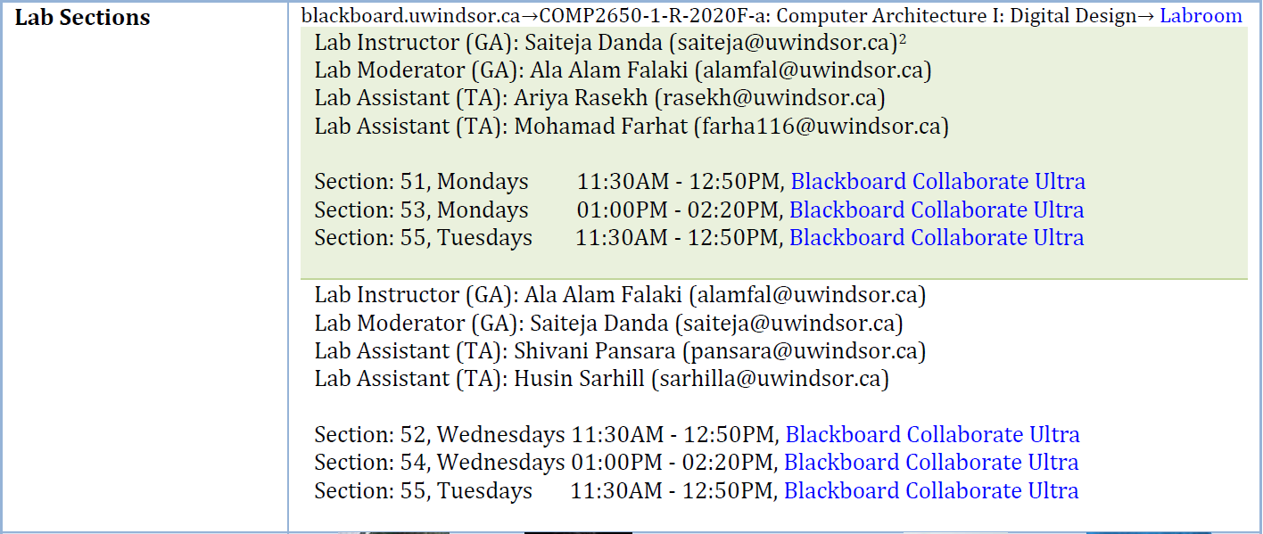
Blackboard Tour | Learning Outcome | Outline (Syllabus) | Laboratory | Discussion Board | Me | Weekly Schedule

Slide 92
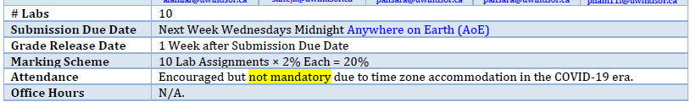
Blackboard Tour | Learning Outcome | Outline (Syllabus) | Laboratory | Discussion Board | Me | Weekly Schedule

Slide 93
Blackboard Tour | Learning Outcome | Outline (Syllabus) | Laboratory | Discussion Board | Me | Weekly Schedule

Slide 94
Blackboard Tour | Learning Outcome | Outline (Syllabus) | Laboratory | Discussion Board | Me | Weekly Schedule

Slide 95
Blackboard Tour | Learning Outcome | Outline (Syllabus) | Laboratory | Discussion Board | Me | Weekly Schedule

Slide 96
Blackboard Tour | Learning Outcome | Outline (Syllabus) | Laboratory | Discussion Board | Me | Weekly Schedule

Slide 97
Blackboard Tour | Learning Outcome | Outline (Syllabus) | Laboratory | Discussion Board | Me | Weekly Schedule

Slide 98
labroom
aka. Laboratory
Labs → How to Attend Lab Sections

Slide 99
Discussion board
Lectures → How To Find → How to Participate in Discussion Board

Slide 100
ME
hfani.myweb.cs.uwindsor.ca

Slide 101

WSDM 2016, 2nd Year PhD, Baker Beach, San Francisco, USA.
Blackboard Tour | Learning Outcome | Outline (Syllabus) | Laboratory | Discussion Board | Me | Weekly Schedule
Notes:
Hossein Fani, http://hfani.myweb.cs.uwindsor.ca/
Education: Ph.D. in CS, Faculty of Computer Science, University of New Brunswick, NB., Canada
Office:
ENG324
Hour
Tuesday 12PM-01PM
Email
hossein.fani@ryerson.ca

Slide 102

Hossein Fani, PhD
Assistant Professor, School of Computer Science, Faculty of Science, University of Windsor
Room 5111, Lambton Tower hfani@uwindsor.ca; hossein.fani@uwindsor.ca
hfani.myweb.cs.uwindsor.ca
Blackboard Tour | Learning Outcome | Outline (Syllabus) | Laboratory | Discussion Board | Me | Weekly Schedule
Notes:
Hossein Fani, http://hfani.myweb.cs.uwindsor.ca/
Education: Ph.D. in CS, Faculty of Computer Science, University of New Brunswick, NB., Canada
Office:
ENG324
Hour
Tuesday 12PM-01PM
Email
hossein.fani@ryerson.ca

Slide 103
OFFICE
Lectures → How To Find → How to Attend Instructor's Office Hours

Slide 104
Weekly schedule
Weekly Schedule

Slide 105
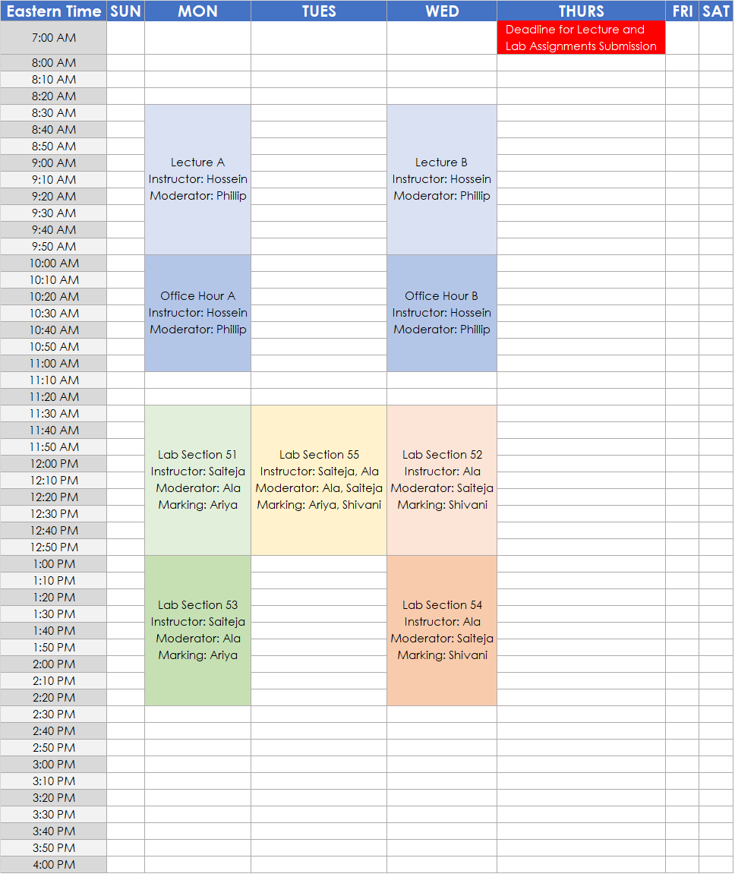
Blackboard Tour | Learning Outcome | Outline (Syllabus) | Laboratory | Discussion Board | Me | Weekly Schedule

Slide 106
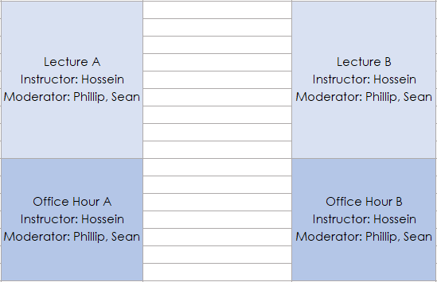
Blackboard Tour | Learning Outcome | Outline (Syllabus) | Laboratory | Discussion Board | Me | Weekly Schedule

Slide 107
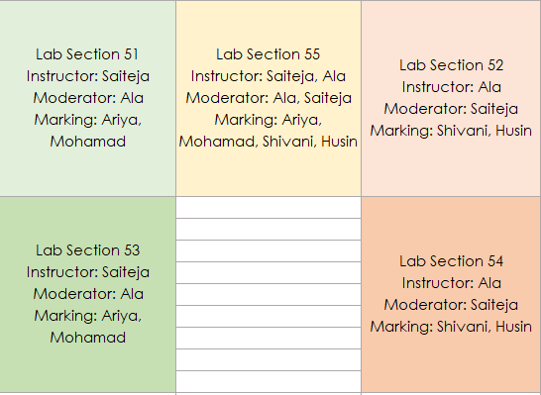
Blackboard Tour | Learning Outcome | Outline (Syllabus) | Laboratory | Discussion Board | Me | Weekly Schedule

Slide 108
Blackboard Tour | Learning Outcome | Outline (Syllabus) | Laboratory | Discussion Board | Me | Weekly Schedule

Slide 109
Codeline
Lectures → W01: Meet & Greet, Number Systems I → Codeline

Slide 110
Thank you!

Slide 111

Question

